Slide 1
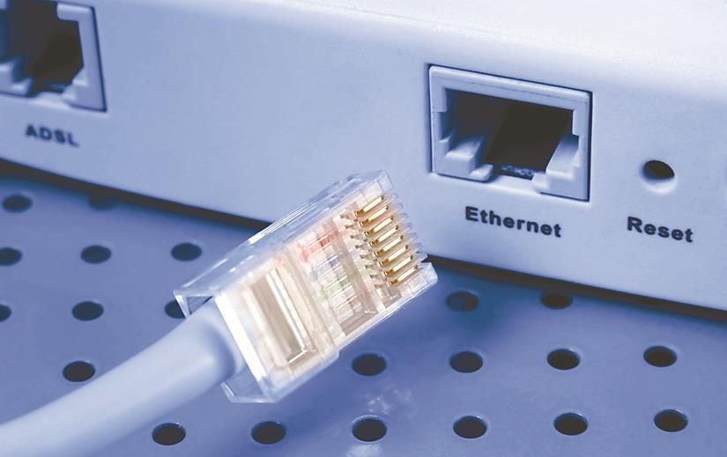
Installing a Physical Network
Chapter 5

Slide 2
Objectives
Recognize and describe the functions of basic components in a structured cabling system
Explain the process of installing structured cable
Install a network interface card
Perform basic troubleshooting on a structured cable network

Slide 3
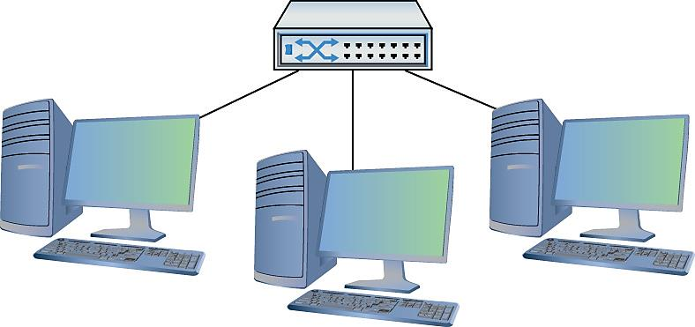
Introduction (1 of 2)
Figure 5.1 What an orderly looking network!

Slide 4
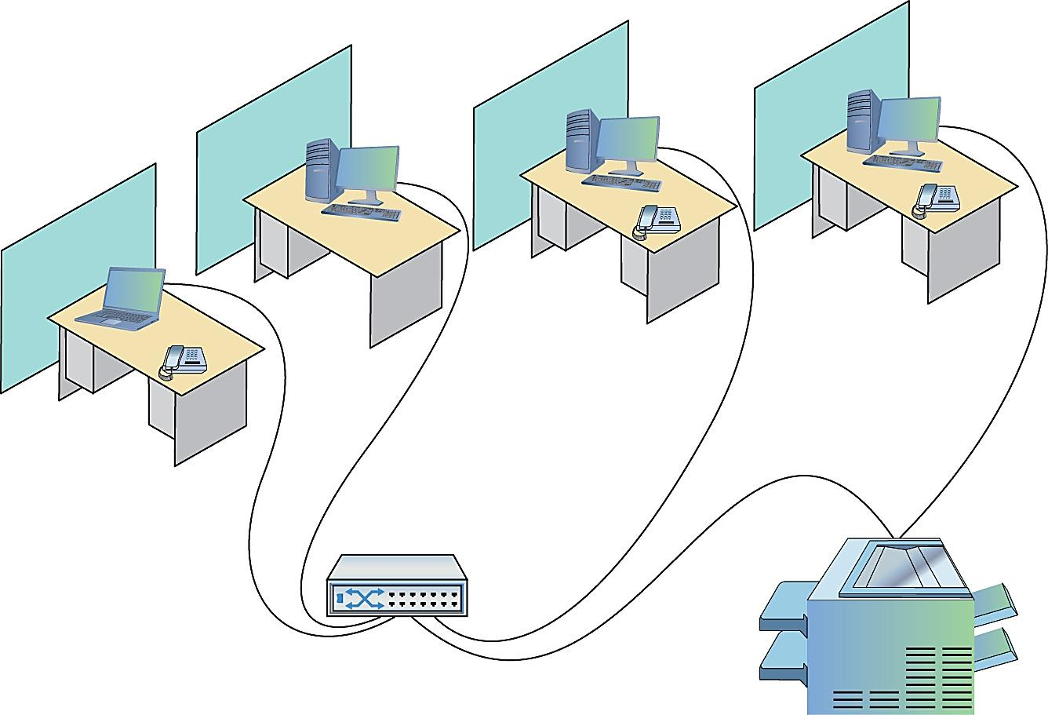
Introduction (2 of 2)
Figure 5.2 A real-world network

Slide 5
Historical/Conceptual
Understanding Structured Cabling

Slide 6
Structured Cabling
Telecommunications Industry Association/Electronic Industries Alliance (TIA/EIA) sets standards for structured cabling
Details on every aspect of cabled network
Examples: type of cabling and position of wall outlets
EIA ceased operations on February 11, 2011
Notes:
Note (p. 89): EIA ceased operations in 2011, but various groups (like TIA) maintain the standards. Expect to see EIA on the CompTIA Network+ exam.

Slide 7
What does Telecommunications Industry Association (TIA) mean?
The Telecommunications Industry Association (TIA) is a trade association which is accredited by the American National Standards Institute (ANSI) in order to develop industry standards for information and communication technologies (ICT) products such as cellular towers, data terminals, VoIP devices, satellites, telephone terminal equipment and many more. TIA has members from all over the industry and currently represents nearly 400 different companies.
TIA was a subdivision of EIA.

Slide 8
The Goal of Structured Cabling
Create a safe, reliable cabling infrastructure
Networks
Telephone
Video
Anything that needs low-power, distributed cabling
Notes:
Note (p. 90): A structured cabling system is useful for more than just computer networks. You’ll find structured cabling defining telephone networks and video conferencing setups, for example.
Tech Tip: Integrating Wi-Fi (p. 90)
Many networks today have a wireless component in addition to a wired infrastructure. The switches, servers, and workstations rely on wires for fast networking, but the wireless component supports workers on the move, such as salespeople. This chapter focuses on the wired infrastructure. Once we get through Wi-Fi in Chapter 14, “Wireless Networking,” I’ll add that component to our networking conversation.

Slide 9
The Focus of This Chapter
Cable basics
Network components
Assessment of connections leading outside the network

Slide 10
Cable Basics – A Star Is Born (1 of 2)
A typical physical star network
A switch
UTP cable
A few PCs

Slide 11
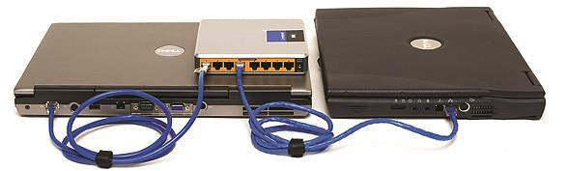
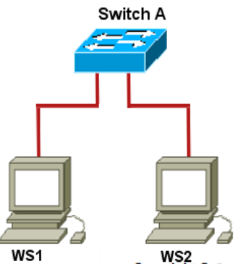
Cable Basics – A Star Is Born (2 of 2)
Figure 5.3 A switch connected by UTP cable
to two PCs

Slide 12
Issues with Installation
Problems with locating a switch in the middle of office space
Exposed cables are vulnerable to physical damage
Tripping hazard
Stepping on cables will cause failure over time
Presence of other devices can create electrical interference
Limits ability to make changes to network

Slide 13
A Better Installation Design
Provides safety
Provides hardware to organize and protect cabling
Uses a cabling standard with flexibility to allow for growth
TIA/EIA developed standards for cable installation
Notes:
Cross Check: TIA/EIA Standards (p. 91)
You should remember the TIA/EIA 568 standards from Chapter 3, “Ethernet Basics,” but do you remember how to tell the difference between 568A and 568B? Why were the standards considered necessary?
Tech Tip: Professional Cabling Certifications with BICSI (p. 91)
Installing structured cabling properly takes a startlingly high degree of skill. Thousands of pitfalls await inexperienced network people who think they can install their own network cabling. Pulling cable requires expensive equipment, a lot of hands, and the ability to react to problems quickly. Network techs can cost employers a lot of money—not to mention losing their good jobs—by imagining they can do it themselves without the proper knowledge. If you are interested in learning more details about structured cabling, an organization called the Building Industry Consulting Service International (BICSI) (www.bicsi.org) provides a series of widely-recognized certifications for the cabling industry.

Slide 14
Test Specific
Structured Cable Network Components

Slide 15
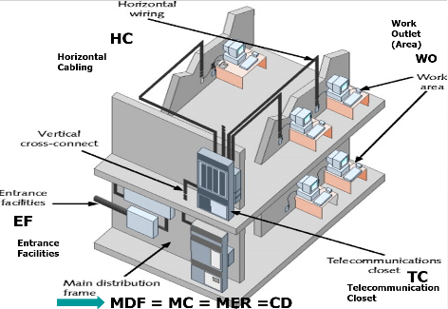
Structured Cable Network Components (1 of 2)
Telecommunications room
All cables concentrate in this one area
Horizontal Cabling [HC](a run)
Work area: office or cubicle

Slide 16
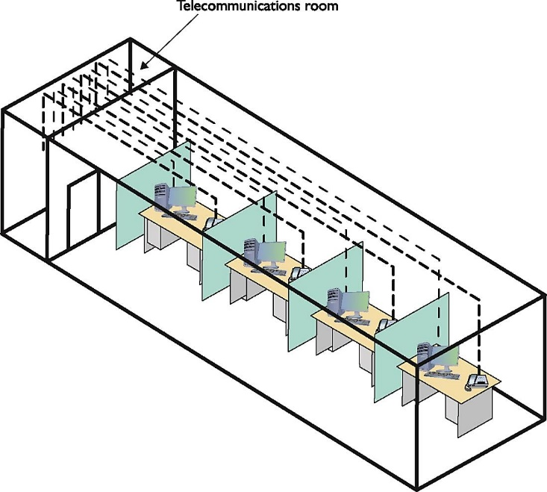
Structured Cable Network Components (2 of 2)
Figure 5.4 Telecommunications room

Slide 17
Horizontal Cabling (1 of 3)
Runs from telecommunications room to PCs
CAT 5e or better UTP
Solid core (better, but can break)
Better conductor than stranded core
Will break if mishandled
Stranded core (can withstand some bending)
Not as good a conductor
Stands up to handling without breaking
Notes:
Exam Tip (p. 92): A single piece of cable that runs from a work area to a telecommunications room is called a run.

Slide 18
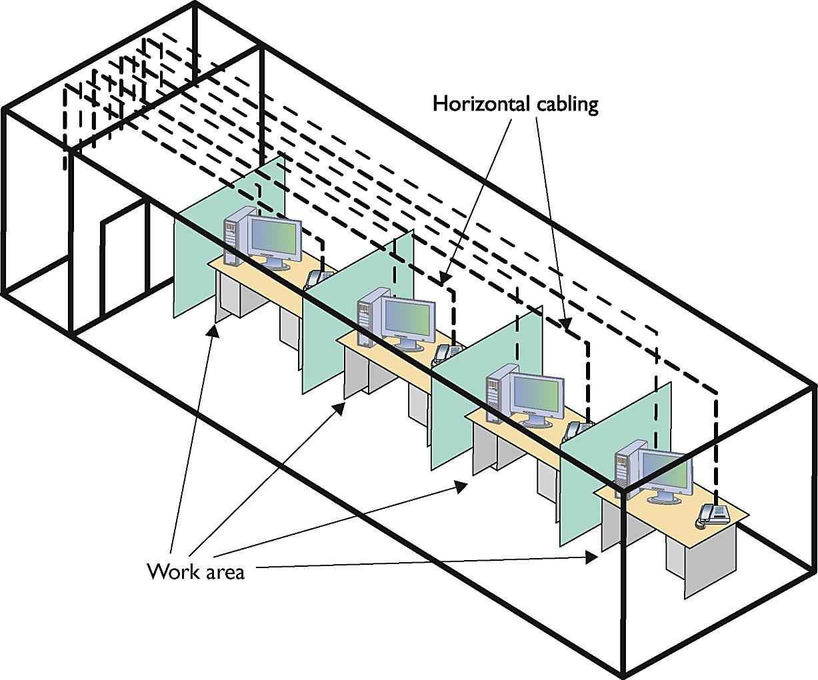
Horizontal Cabling (2 of 3)
Figure 5.5 Horizontal cabling and work area

Slide 19
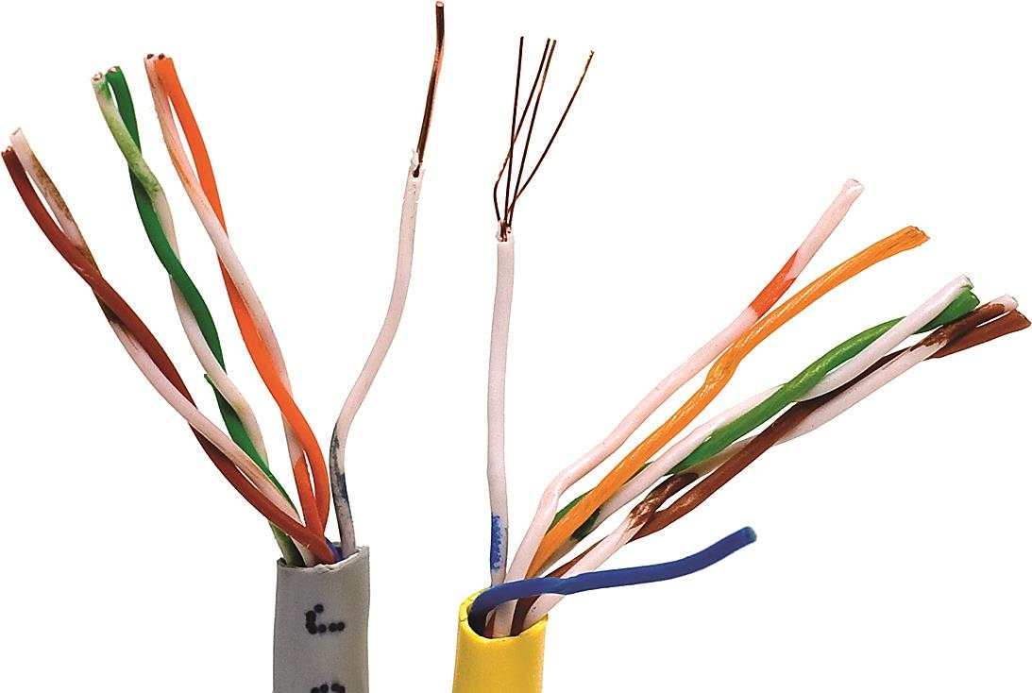
Horizontal Cabling (3 of 3)
Solid Wires
Stranded
Wires
Figure 5.6 Solid and stranded core UTP

Slide 20
TIA/EIA Specifications (1 of 2)
TIA/EIA specifies Horizontal Cabling should always be solid core
Horizontal cabling – number of strands
Four-pair UTP assumed
High-end telephone setups use 25- or 100-pair
Notes:
Note (p. 93): Unlike previous CAT standards, TIA/EIA defines CAT 5e and later as four-pair-only cables.

Slide 21
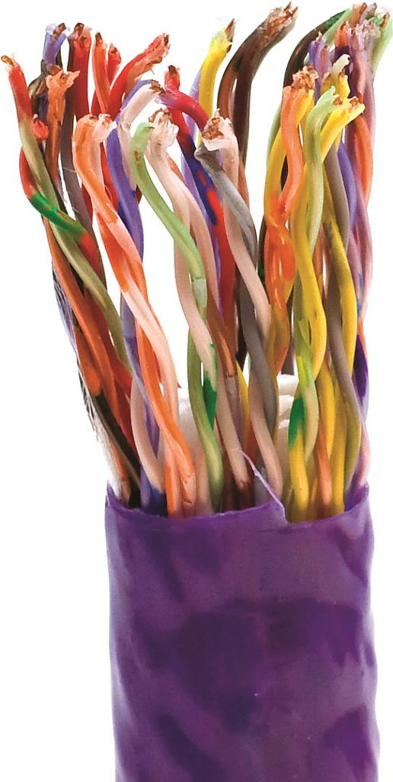
TIA/EIA Specifications (2 of 2)
Figure 5.7 25-pair UTP
Notes:
Cross Check: Fire Ratings (p. 93)
You saw another aspect of cabling way back in Chapter 2, Cabling and Topology,” so check your memory here. What are fire ratings? When should you use plenum-grade cabling and when should you use riser-grade cabling? What about PVC? What are the differences?

Slide 22
Choosing Your Horizontal Cabling
CAT 5e or CAT 6 UTP
CAT 6a for 10GBaseT
Install higher-rated cable for future technologies
Network installers may bid an installation using the lowest grade cable possible

Slide 23
The Telecommunications Room
Heart of basic star
Intermediate distribution frame (IDF)
Endpoint of all horizontal runs from all work areas
Potentially messy place
Organization is needed
Notes:
Note (p. 93): The telecommunications room is also known as an intermediate distribution frame (IDF), as opposed to the main distribution frame (MDF), which we will discuss later in the chapter.

Slide 24
Equipment Racks (1 of 4)
Central component: equipment racks
All racks are 19 inches wide
Rack Height measured in Units (U)
Most rack-mounted devices are 1U, 2U, or 4U
Types of racks
Two post
Four post
Server rail rack
Notes:
Note (p. 94): Equipment racks evolved out of the railroad signaling racks from the 19th century. The components in a rack today obviously differ a lot from railroad signaling, but the 19" width has remained the standard for well over 100 years.

Slide 25
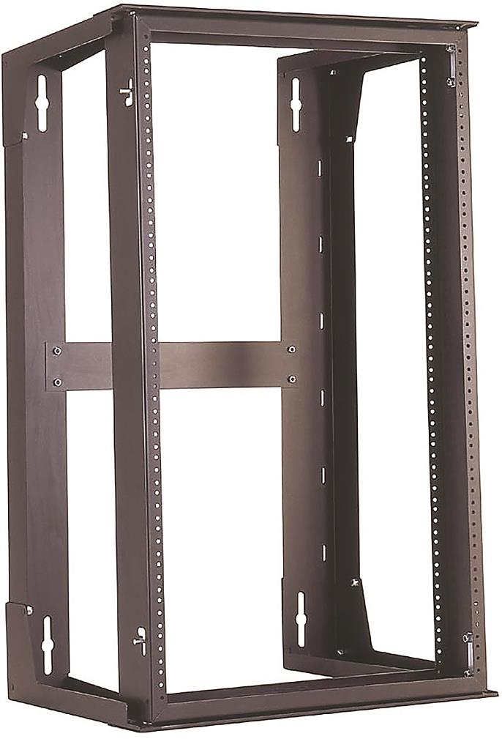
Equipment Racks (2 of 4)
Figure 5.8 A short equipment rack

Slide 26
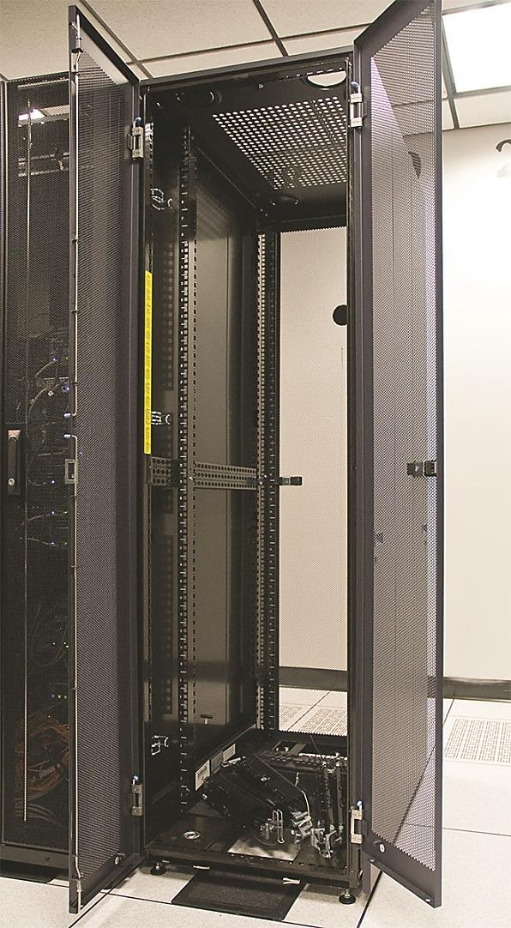
Equipment Racks (3 of 4)
Figure 5.9 A free-standing rack

Slide 27
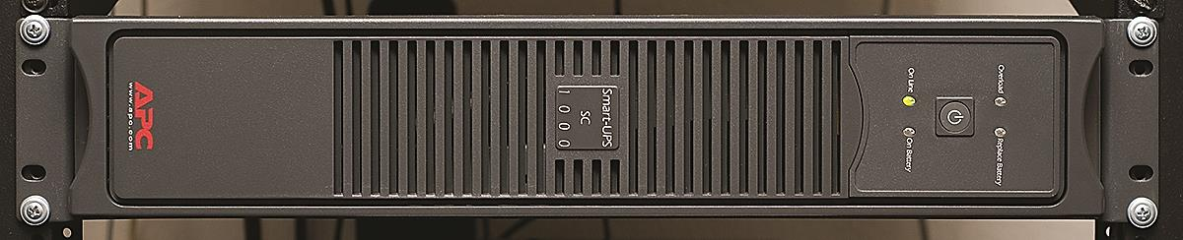
Equipment Racks (4 of 4)
Figure 5.10 A rack-mounted UPS
(Uninterruptible Power Supply)

Slide 28
Patch Panels (1 of 6)
A box with a row of female (ports) in front
Permanent connections in back for connecting horizontal cables
110 block
Connect cables with punchdown tool
Proper labeling is crucial to organization of cables
Notes:
The 110 block introduces less crosstalk than 66 blocks, so most modern installations of high-speed networks use it instead.

Slide 29
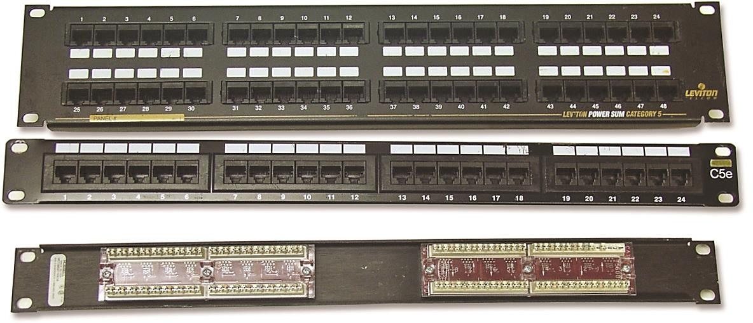
Patch Panels (2 of 6)
Figure 5.11 Typical patch panels

Slide 30
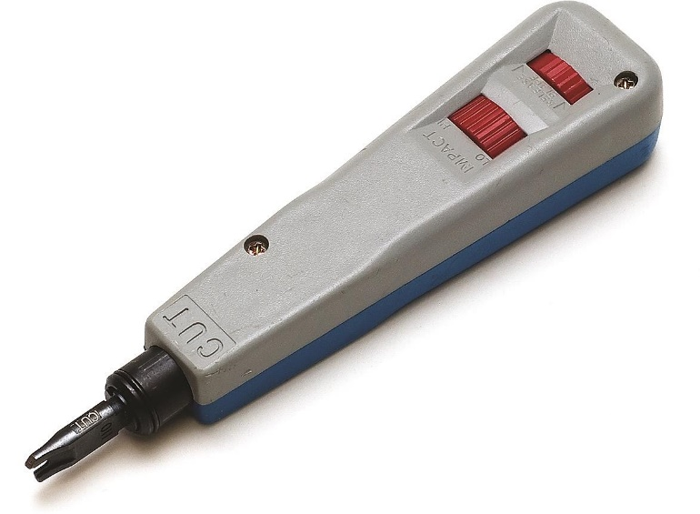
Patch Panels (3 of 6)
Figure 5.12 Punchdown tool

Slide 31
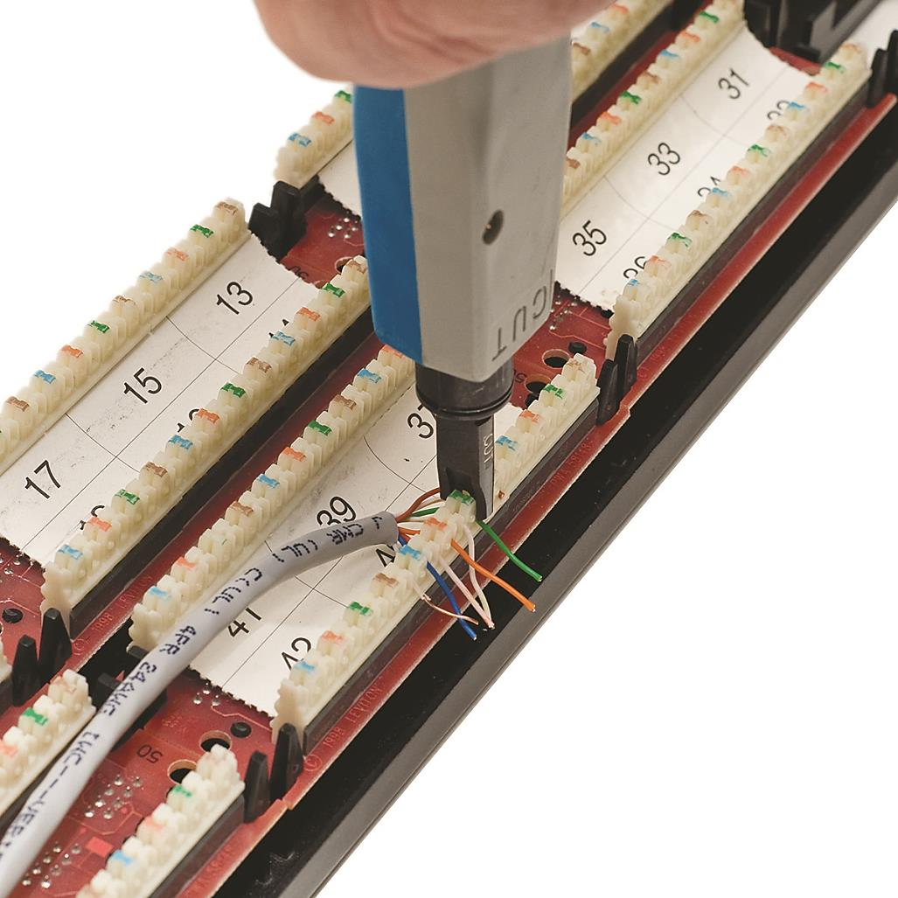
Patch Panels (4 of 6)
Figure 5.13 Punching down a 110 block
Notes:
Note (p. 95): Make sure you insert the wires according to the same standard (TIA/EIA 568A or TIA/EIA 568B) on both ends of the cable. If you don’t, you might end up swapping the sending and receiving wires (known as TX/RX reversed) and inadvertently creating a crossover cable.

Slide 32
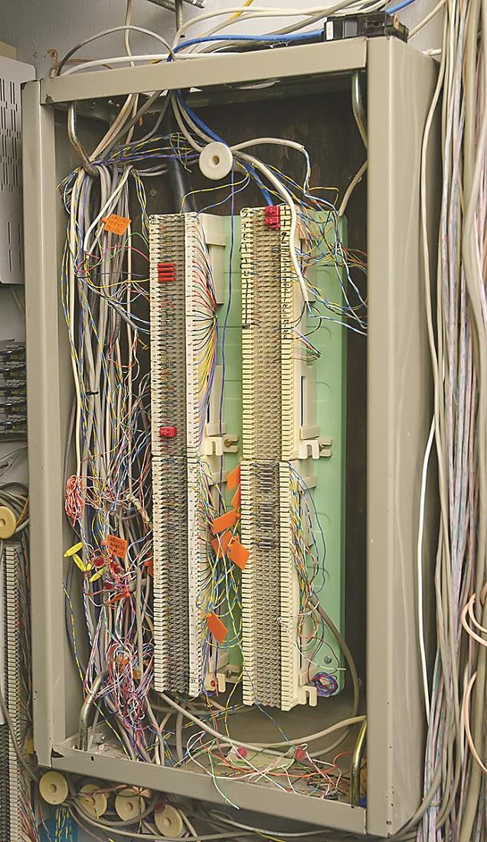
Patch Panels (5 of 6)
Figure 5.14 66-block patch panels
Notes:
Exam Tip (p. 96): The CompTIA Network+ exam uses the terms 110 block and 66 block exclusively to describe the punchdown blocks common in telecommunication. In the field, in contrast, and in manuals and other literature, you’ll see the punchdown blocks referred to as 110-punchdown blocks and 66-punchdown blocks as well. Some manufacturers even split punchdown into two words, i.e., punch down. Be prepared to be nimble in the field, but expect 110 block and 66 block on the exam.

Slide 33
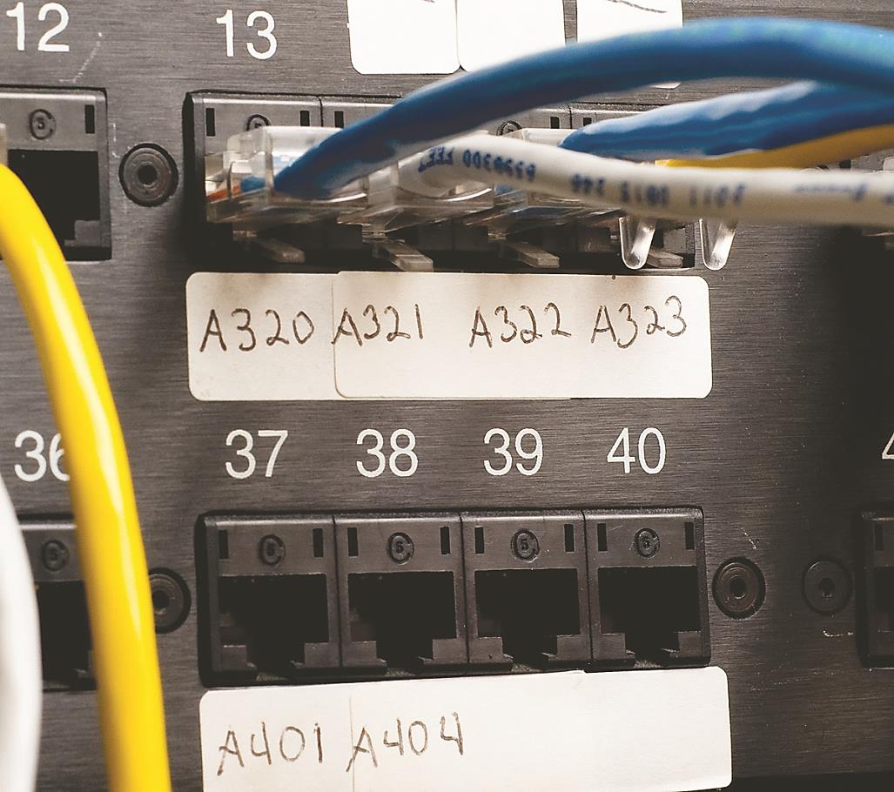
Patch Panels (6 of 6)
Figure 5.15 Typical patch panels with labels
Notes:
Tech Tip: Serious Labeling (p. 96)
The ANSI/TIA-606-C standard covers proper labeling and documentation of cabling, patch panels, and wall outlets. If you want to know how the pros label and document a structured cabling system (and you’ve got some cash to blow), check out the ANSI/TIA-606-C naming conventions from TIA.

Slide 34
Patch Panel Configurations (1 of 2)
UTP, STP, or fiber ports
8, 12, 24, 48, or more ports
CAT rating
CAT 6 or CAT 6a recommended
Higher-rated panels support earlier standards

Slide 35
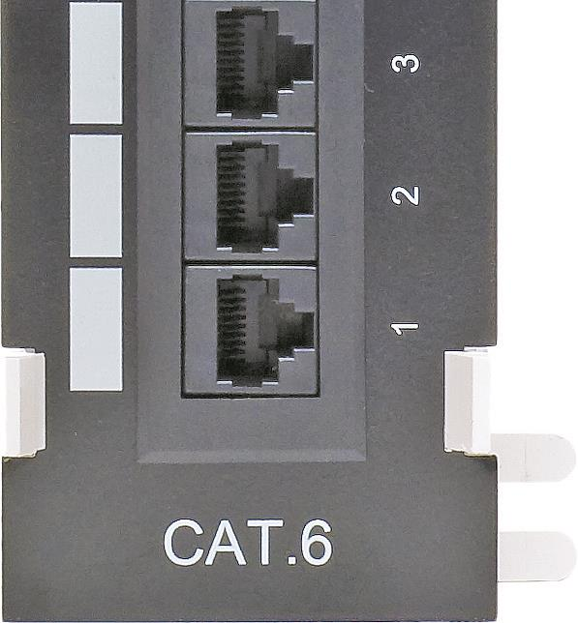
Patch Panel Configurations (2 of 2)
Figure 5.16 CAT level on patch panel

Slide 36
Patch Cables (1 of 3)
Connect the ports to the switch
Short (two to five feet)
Straight-through UTP cables
Stranded cable to tolerate more handling
Different colors facilitate organization
Most have reinforced (booted) connector

Slide 37
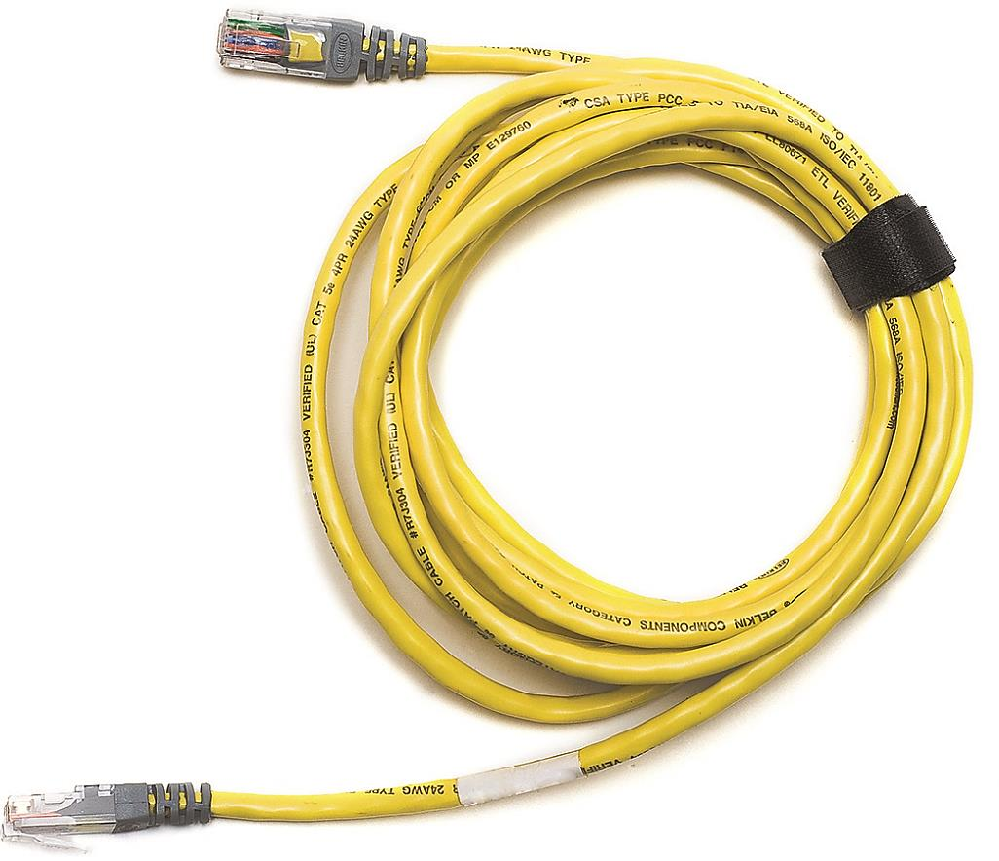
Patch Cables (2 of 3)
Figure 5.17 Typical patch cable

Slide 38
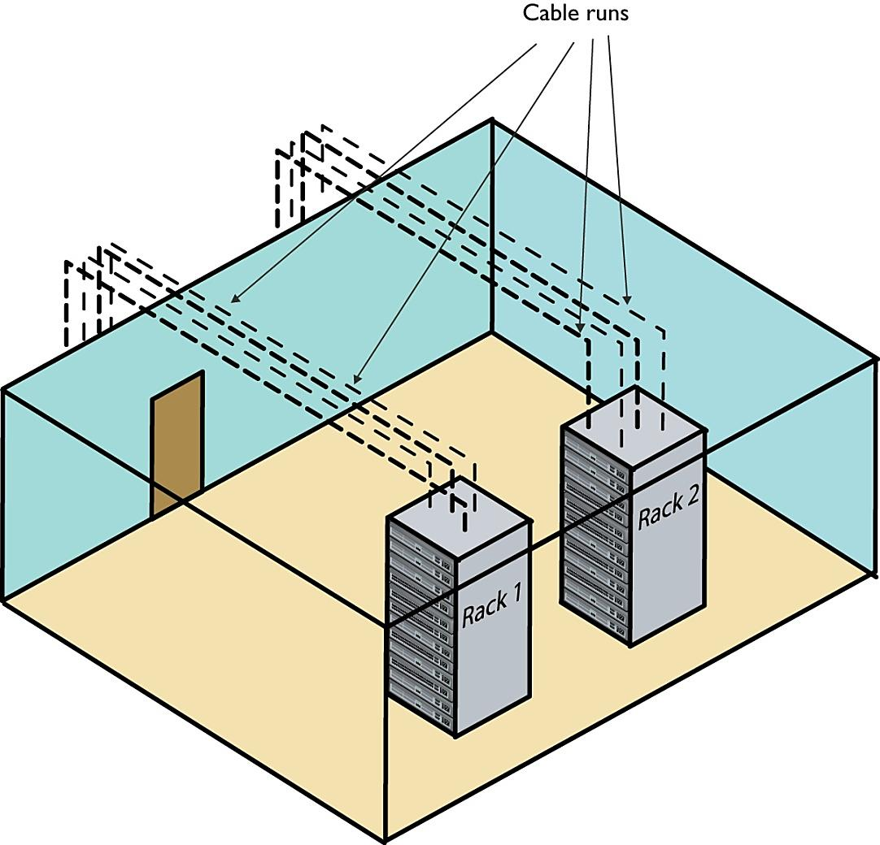
Patch Cables (3 of 3)
Figure 5.18 Network taking shape, with racks installed and horizontal cabling run
Notes:
Exam Tip (p. 97): Some mission-critical networks require specialized electrical hardware. Although the CompTIA Network+ exam doesn’t refer to these boxes by name—rack mounted AC distribution boxes—it dances around some of the features. Notably, an AC distribution system can supply multiple dedicated AC circuits to handle any challenging setups.
If you install such a box in your rack, make sure to add labels to both systems and circuits. Proper system labeling and circuit labeling can make life much easier in the event of problems later on.

Slide 39
The Work Area (1 of 4)
A wall outlet that serves as the termination point for horizontal cables
One or two female jacks to accept cabling
CAT ratings
Mounting plate and faceplate components
PC connects to a wall outlet via a patch cable
Source of most network failures

Slide 40
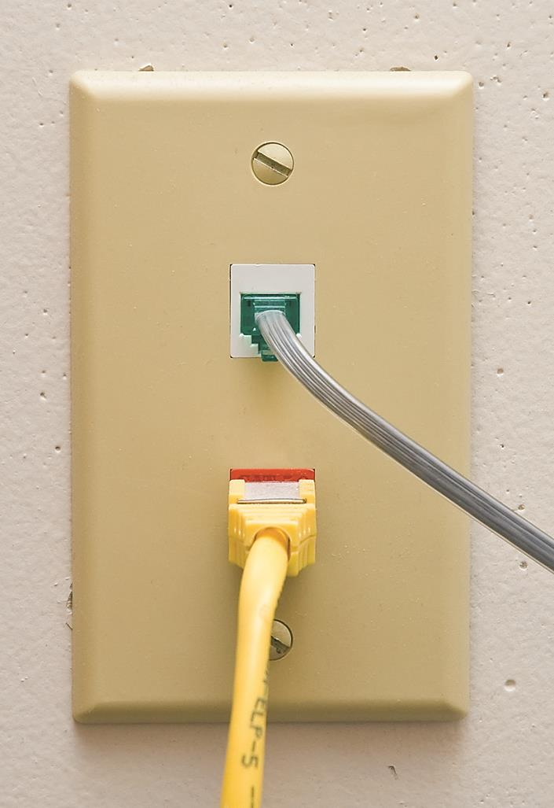
The Work Area (2 of 4)
Figure 5.19 Typical work area outlet

Slide 41
The Work Area (3 of 4)
Connect the PC to the wall outlet
Patch cable commonly used
Patch cables add extra distance between the switch and the PC
TIA/EIA specification allows only UTP cable lengths of 90 meters

Slide 42
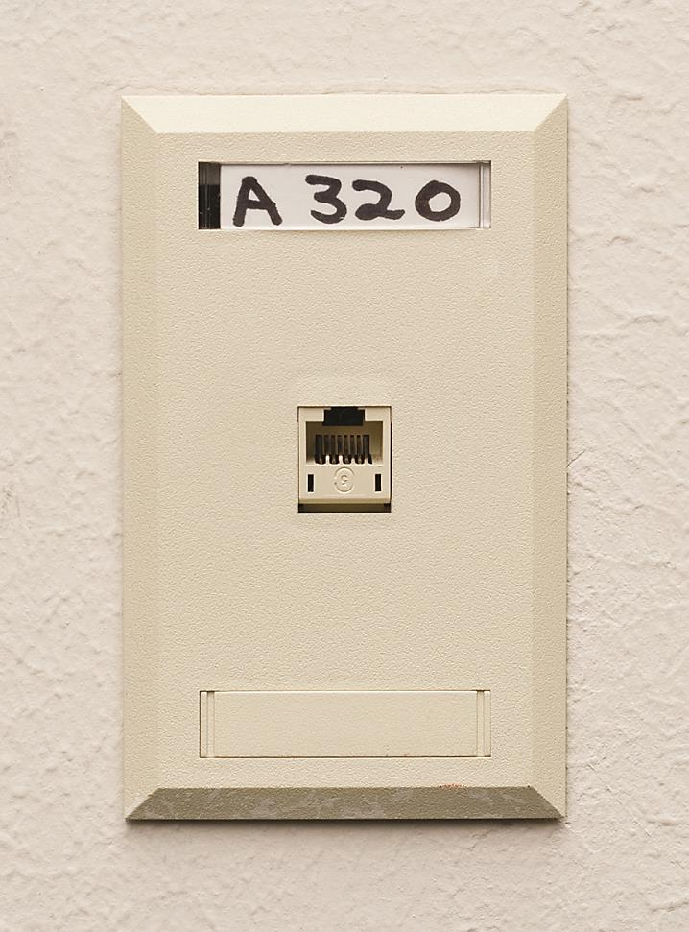
The Work Area (4 of 4)
Figure 5.20 Properly labeled outlet

Slide 43
Structured Cable – Beyond the Star (1 of 2)
Cabling on one floor a single star topology
Cabling an entire building more complex
Most LANs connect to both Internet and telephone company
Notes:
Note (p. 99): Structured cabling goes beyond a single building and even describes methods for interconnecting multiple buildings. The CompTIA Network+ certification exam does not cover interbuilding connections.

Slide 44
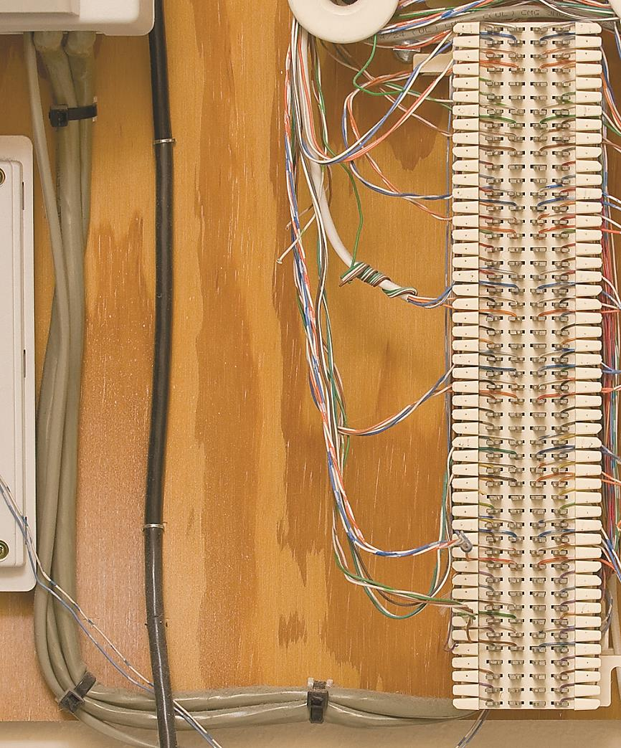
Structured Cable – Beyond the Star (2 of 2)
Figure 5.21 25-pair UTP cables running to local 66-block

Slide 45
Demarc and NIU (1 of 3)
Demarcation point (demarc)
Refers to the physical location of the connection
Marks the dividing line of responsibility for network function
Network interface unit (NIU)
Serves as a demarc between a home network and ISP

Slide 46
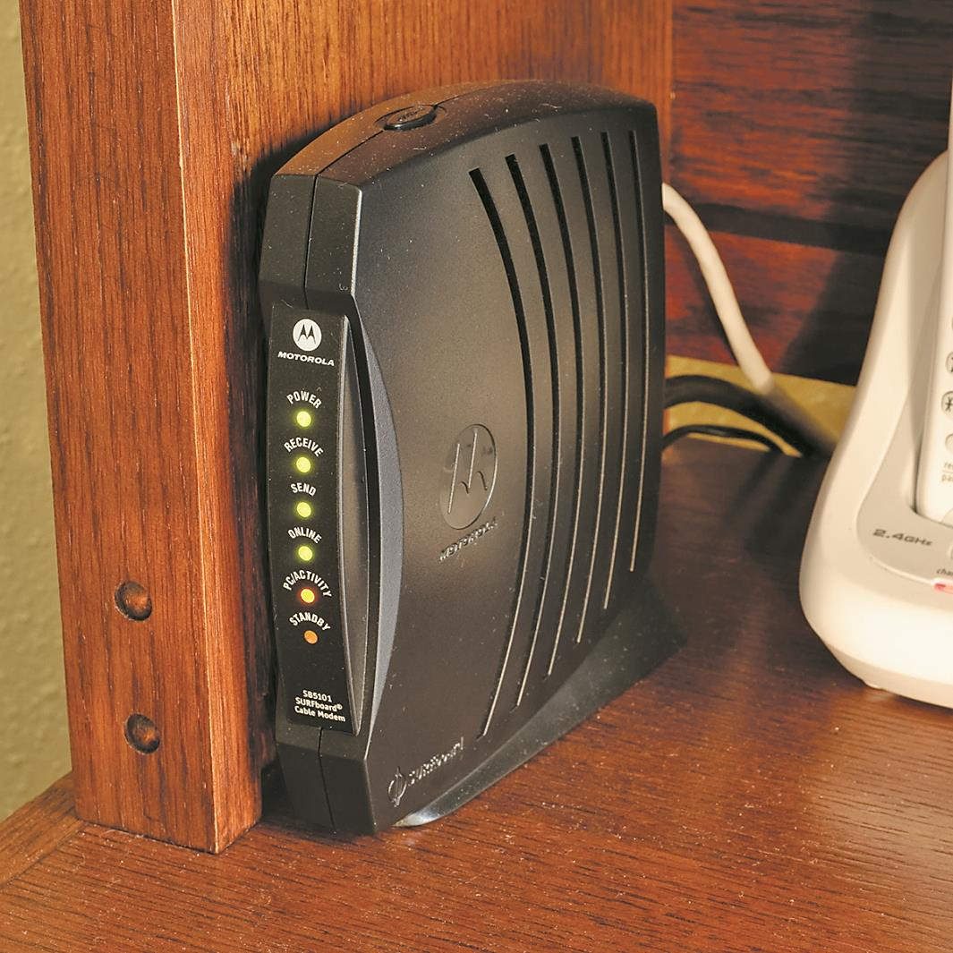
Demarc and NIU (2 of 3)
Figure 5.22 Typical home network interface box
Notes:
Tech Tip: NIU=NIB=NID: Huh? (p. 100)
The terms used to describe the devices that often mark the demarcation point in a home or office get tossed about with wild abandon. Various manufacturers and technicians call them network interface units, network interface boxes, or network interface devices. (Some techs call them demarcs, just to muddy the waters further, but we won’t go there.) By name or by initial—NIU, NIB, or NID—it’s all the same thing, the box that marks the point where your responsibility begins on the inside.

Slide 47
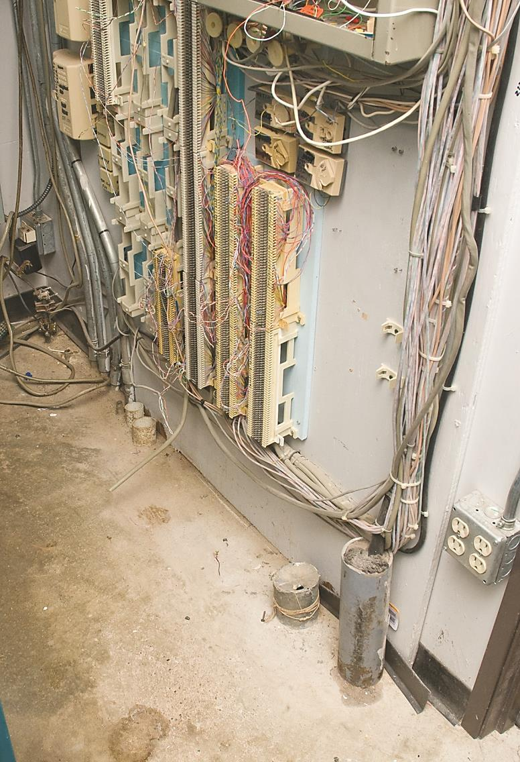
Demarc and NIU (3 of 3)
Figure 5.23 Typical office demarc
Notes:
Note (p. 100): The best way to think of a demarc is in terms of responsibility. If something breaks on one side of the demarc, it’s your problem; on the other side, it’s the ISP/phone company’s problem.

Slide 48
Connections Inside the Demarc (1 of 5)
Challenge to ISP/telephone provider
The need to diagnose system faults
Smart jacks
NIUs with remote loopback capability
Connections inside the demarc
Network and telephone cables connect to customer-premises equipment (CPE)

Slide 49
Connections Inside the Demarc (2 of 5)
Cabling that runs from the NIU to the CPE
Might be a multiplexer or a LAN switch connected to a patch panel
Main patch panel is called a vertical cross-connect

Slide 50
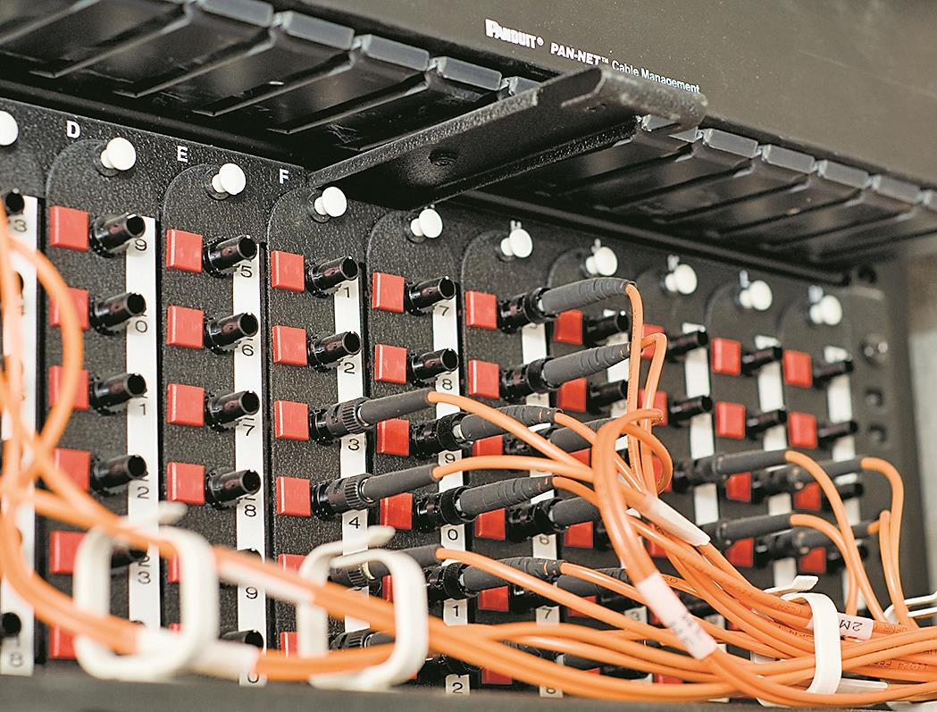
Connections Inside the Demarc (3 of 5)
Figure 5.24 LAN vertical cross-connect

Slide 51
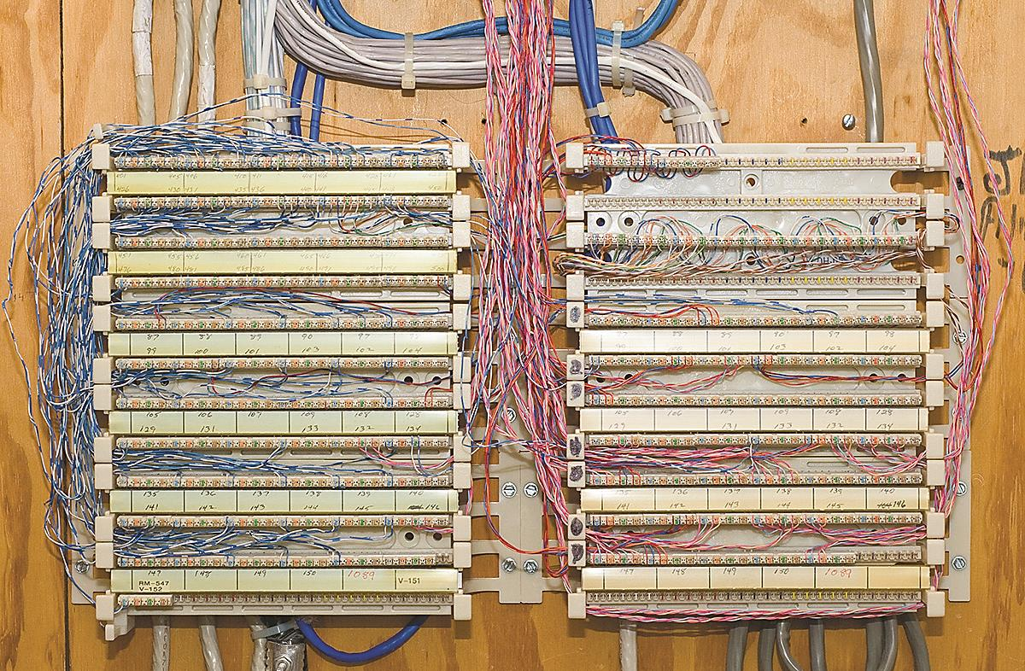
Connections Inside the Demarc (4 of 5)
Figure 5.25 Telephone vertical cross-connect

Slide 52
Connections Inside the Demarc (5 of 5)
The room that stores the demarc, telephone cross-connects, and LAN cross-connects
Different from individual telecommunications rooms that serve individual floors
Actual building and customer needs determine structured cabling system design

Slide 53
Installing Structured Cabling

Slide 54
Getting a Floor Plan (1 of 2)
Key to proper planning
Determine potential locations for telecommunications rooms
Locate physical firewalls
Gives an overall feel for the scope of the job
If no floor plan exists, create one

Slide 55
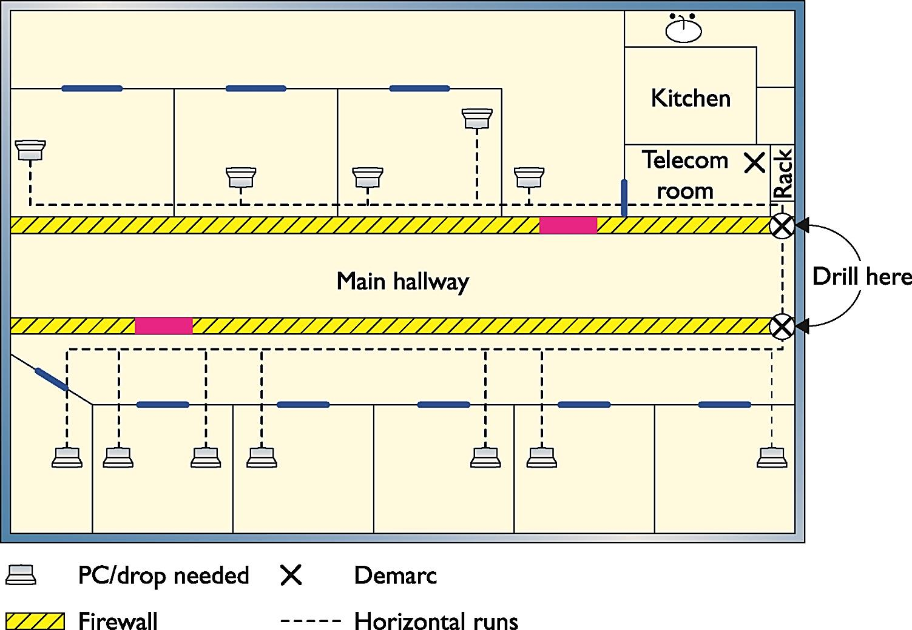
Getting a Floor Plan (2 of 2)
Figure 5.26 Hand-drawn network floor plan

Slide 56
Mapping the Runs (1 of 2)
Determine the length of cable runs
Determine the route of cable runs
Determine the location of each cable drop
Pricing
Most network installers quote a per-drop cost
Raceway products allow cables to run outside the walls
Notes:
Exam Tip (p. 103): Watch out for the word drop, as it has more than one meaning. A single run of cable from the telecommunications room to a wall outlet is often referred to as a “drop.” The word “drop” is also used to define a new run coming through a wall outlet that does not yet have a jack installed.

Slide 57
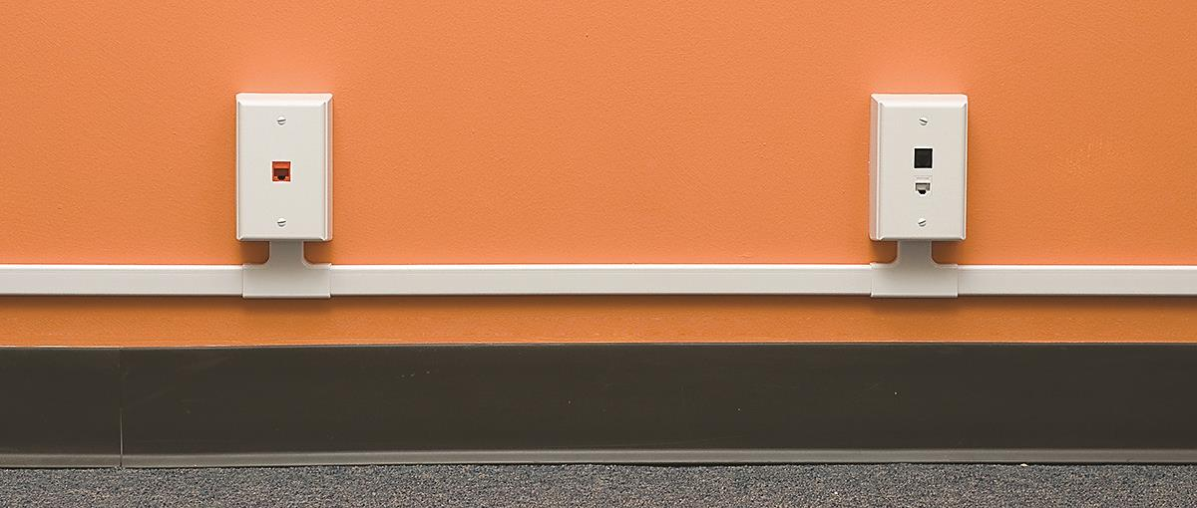
Mapping the Runs (2 of 2)
Figure 5.27 A typical raceway

Slide 58
Determining the Telecommunications Room Location (1 of 2)
Distance of no more than 90 meters from drops
Equipment power requirements
Humidity
Cooling
Access
Expandability

Slide 59
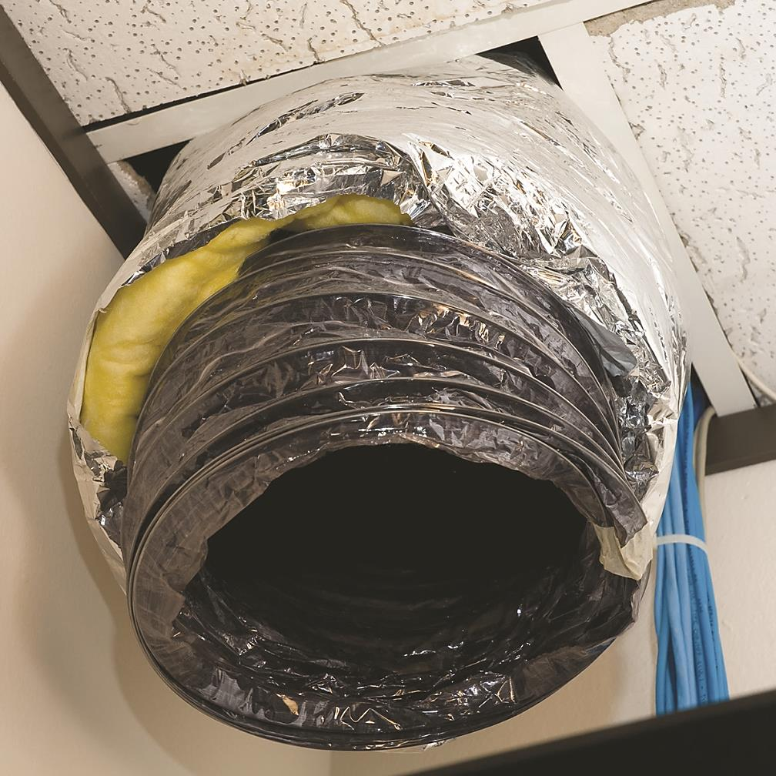
Determining the Telecommunications Room Location (2 of 2)
Figure 5.28 An A/C duct cooling a telecommunications room

Slide 60
Pulling Cable (1 of 9)
Requires two to three people
Start in telecommunications room and pull toward drops
Open drop ceiling and string via hooks or cable trays
Use correct tools
Hardest part: working around old cable installations in the ceiling

Slide 61
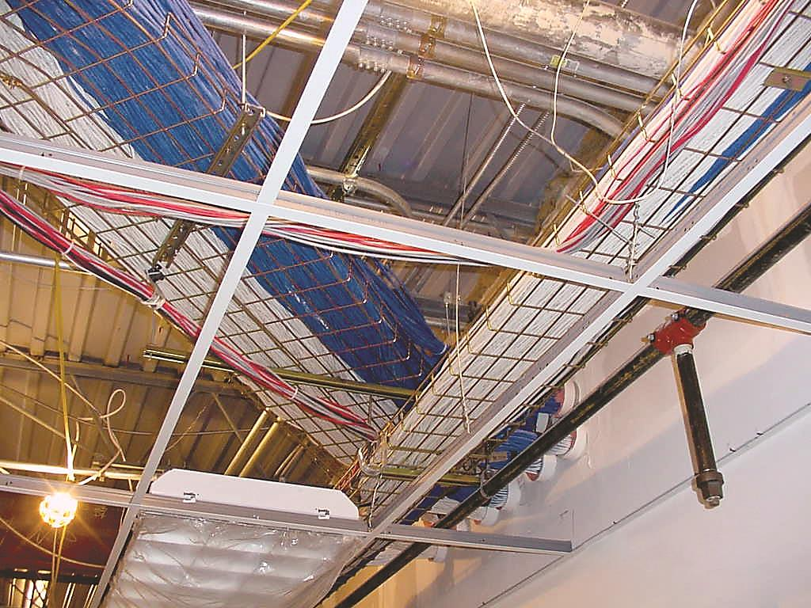
Pulling Cable (2 of 9)
Figure 5.29 Cable trays over a drop ceiling

Slide 62
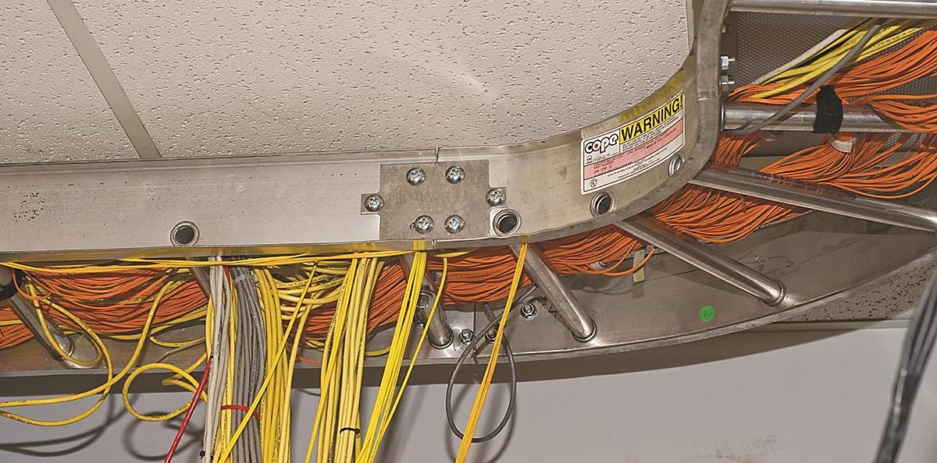
Pulling Cable (3 of 9)
Figure 5.30 Messy cabling nightmare

Slide 63
Pulling Cable (4 of 9)
Follow local codes, TIA/EIA, and NEC
Vertical drops require a lot of skill
Install a low-voltage mounting bracket to hold faceplate
Use cable guides to bring the cables down to the equipment rack

Slide 64
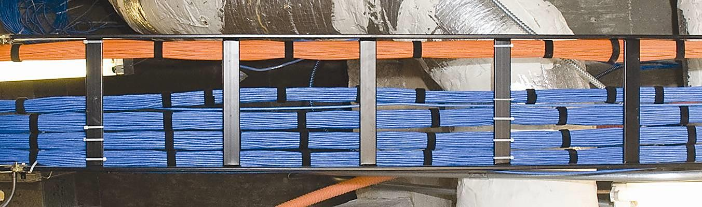
Pulling Cable (5 of 9)
Figure 5.31 Nicely run cables
(image is vertical in the book)

Slide 65
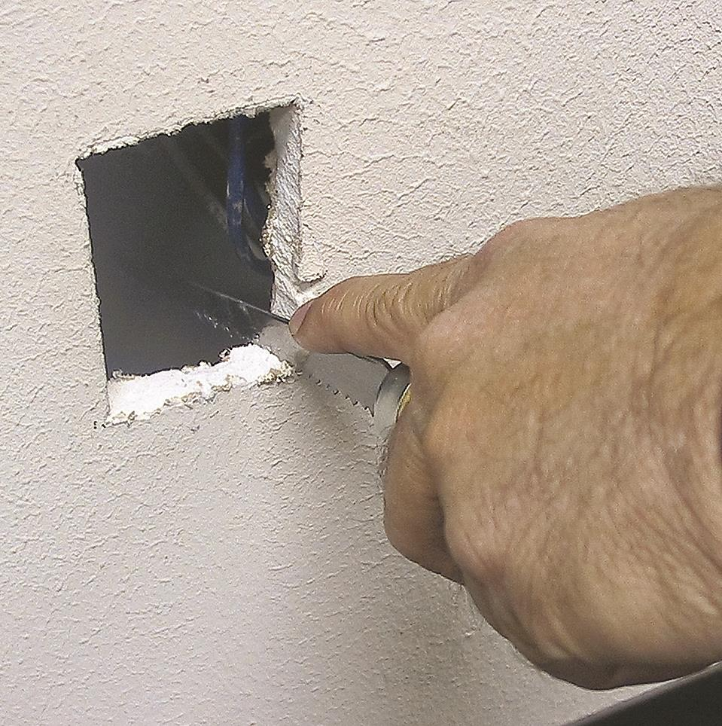
Pulling Cable (6 of 9)
Figure 5.32 Cutting a hole

Slide 66
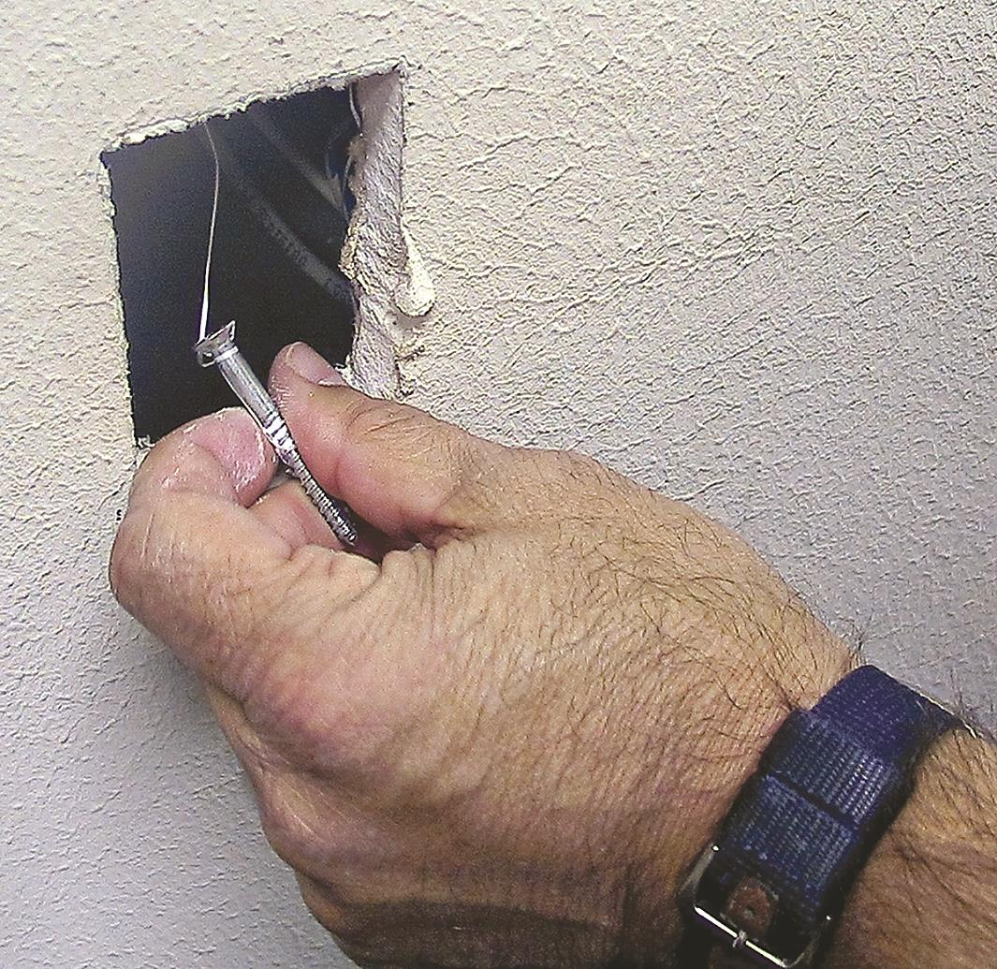
Pulling Cable (7 of 9)
Figure 5.33 Locating a dropped pull rope

Slide 67
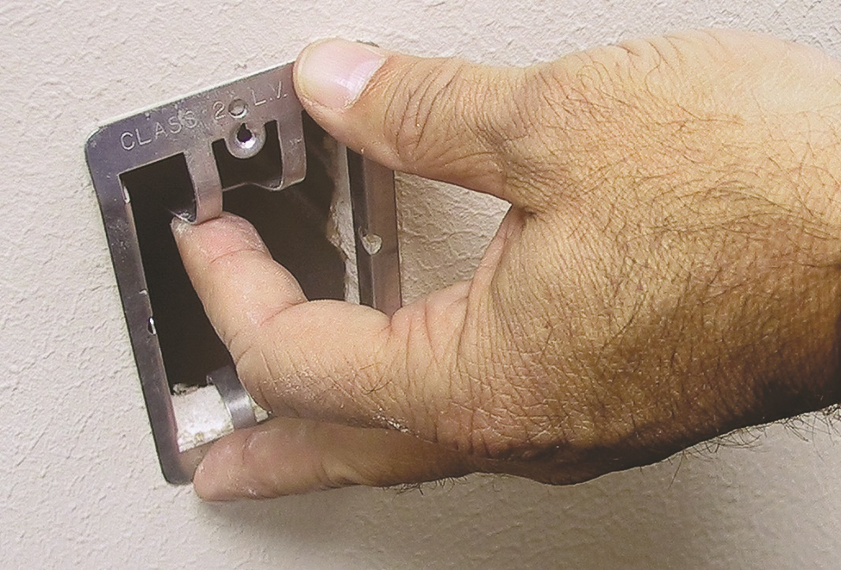
Pulling Cable (8 of 9)
Figure 5.34 Installing a mounting bracket

Slide 68
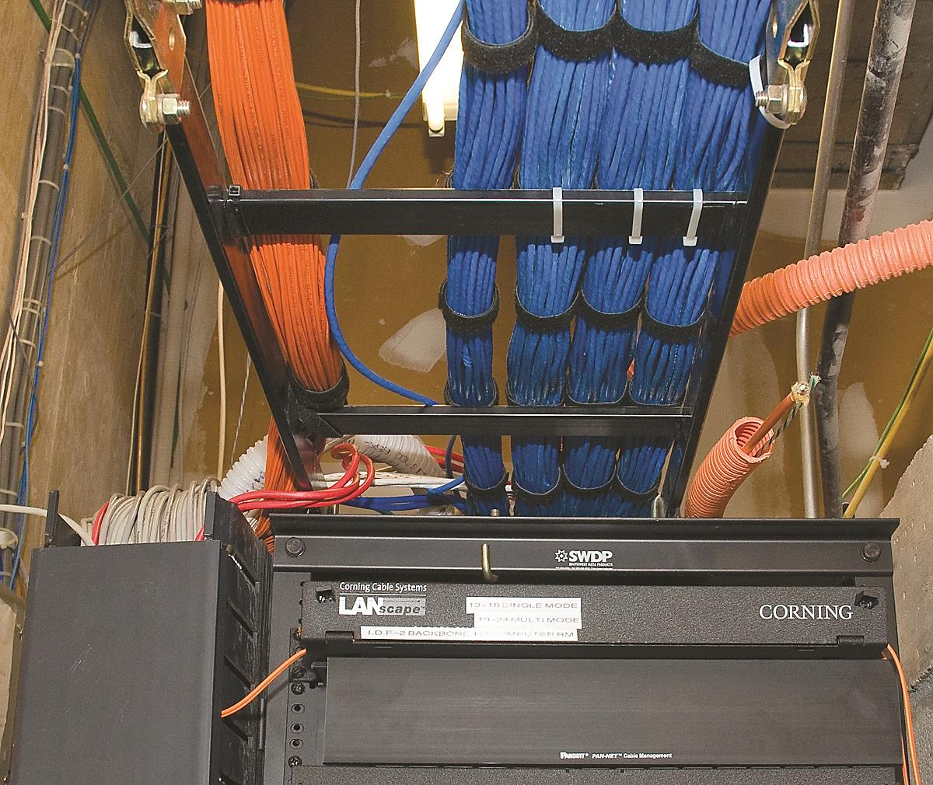
Pulling Cable (9 of 9)
Figure 5.35 End of cables guided to rack

Slide 69
Making Connections (1 of 2)
Connecting the work areas
Crimp a wall jack to wire
Mount the faceplate
Fit the jack into the faceplate

Slide 70
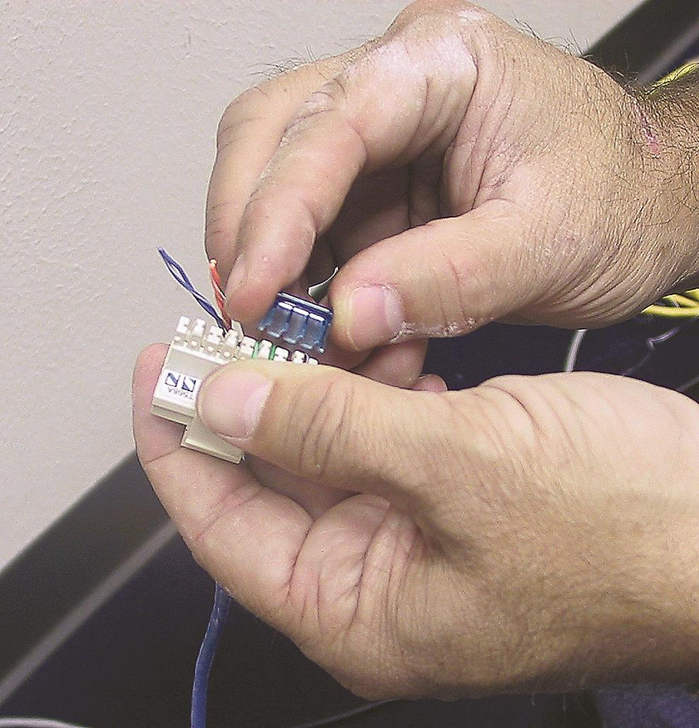
Making Connections (2 of 2)
Figure 5.36 Crimping a jack

Slide 71
Rolling Your Own Patch Cables (1 of 7)
Use stranded UTP cable matching the CAT level of the horizontal runs
Use a special crimp for stranded cable
RJ-45 crimper with built-in stripper
Wire snips
See step-by-step instructions and Figures 5.37 through 5.42 in the text

Slide 72
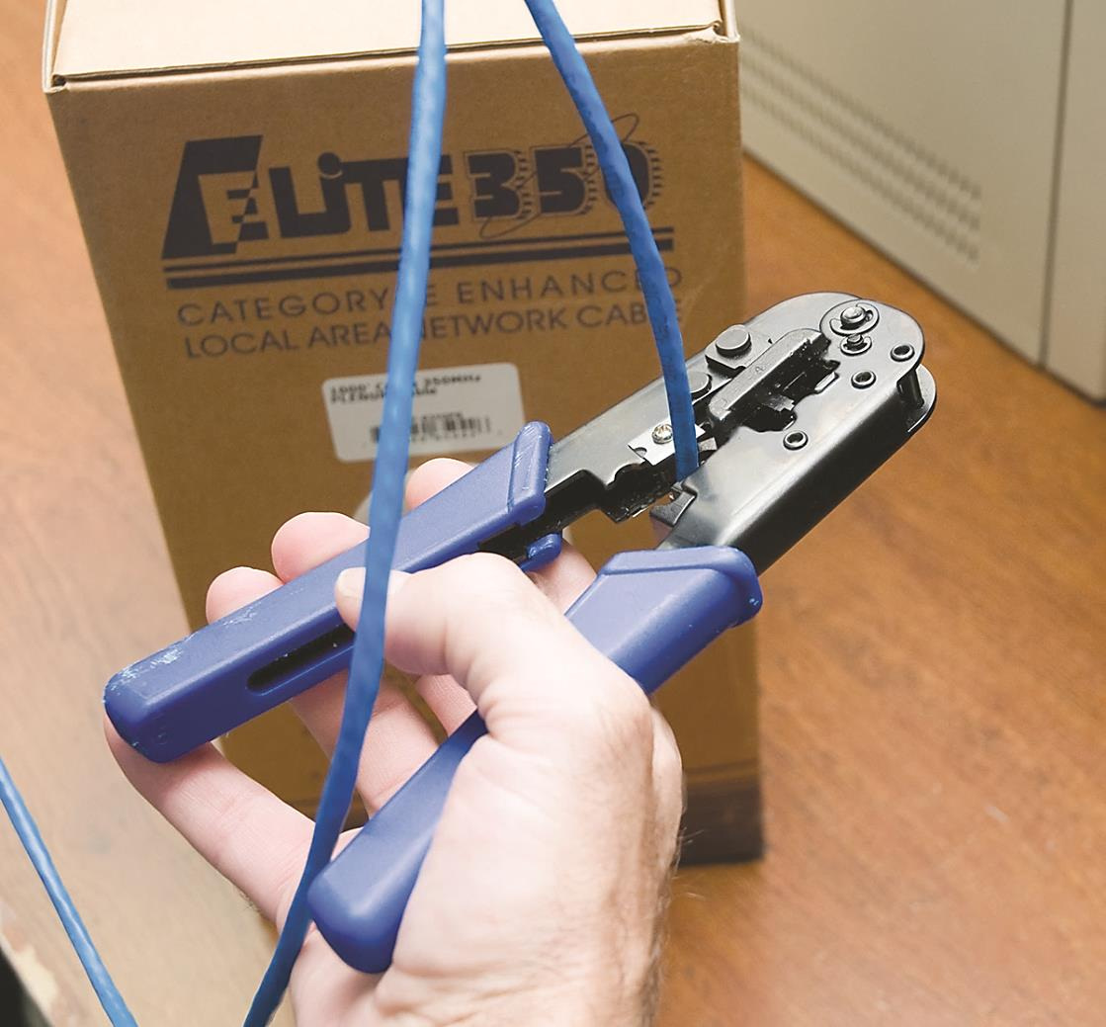
Rolling Your Own Patch Cables (2 of 7)
Figure 5.37 Crimper and snips

Slide 73
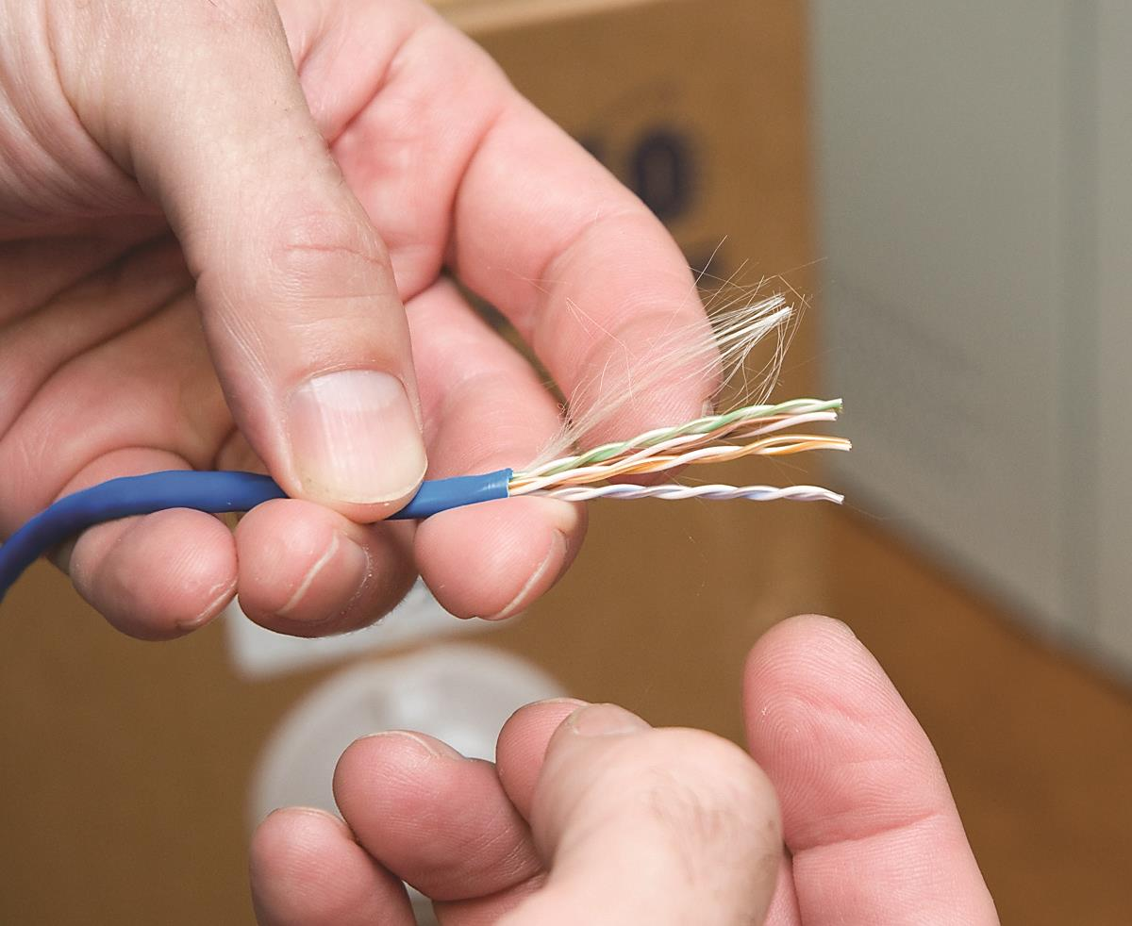
Rolling Your Own Patch Cables (3 of 7)
Figure 5.38 Properly stripped cable

Slide 74
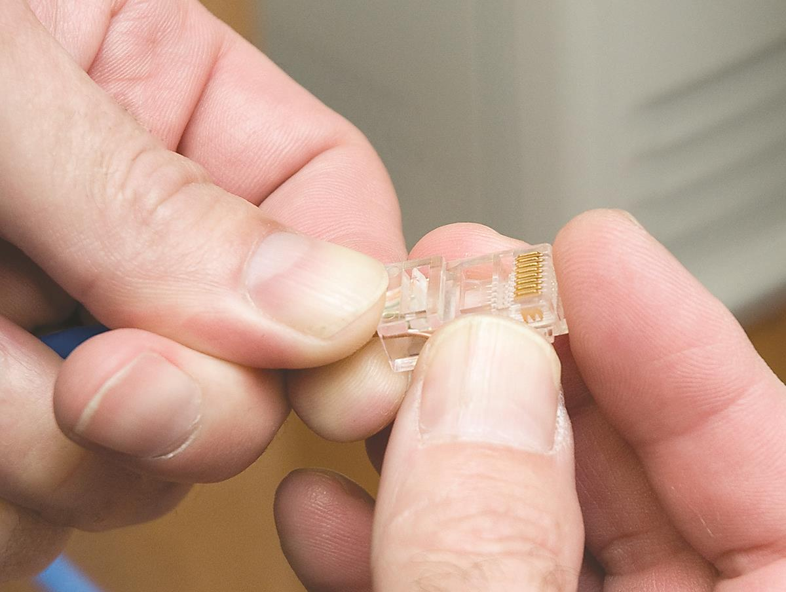
Rolling Your Own Patch Cables (4 of 7)
Figure 5.39 Inserting the individual strands

Slide 75
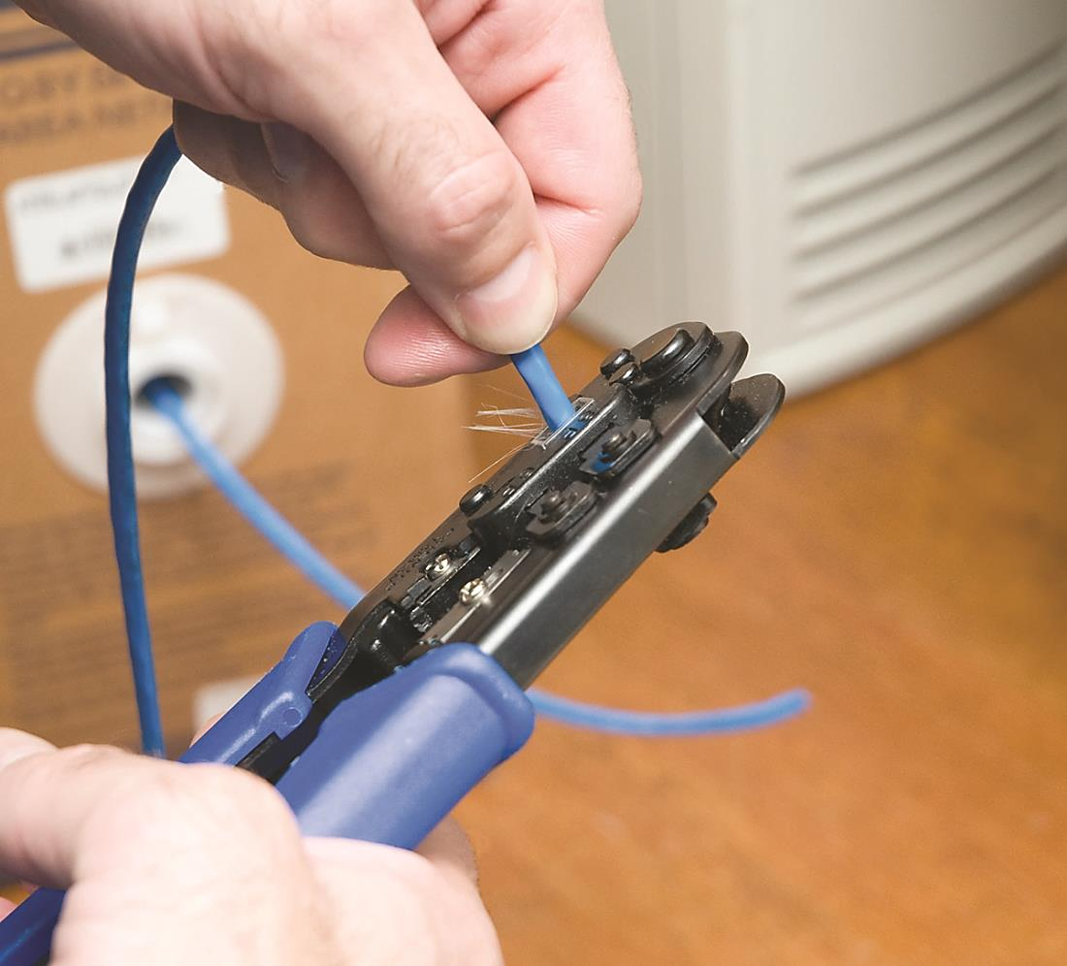
Rolling Your Own Patch Cables (5 of 7)
Figure 5.40 Crimping the cable

Slide 76
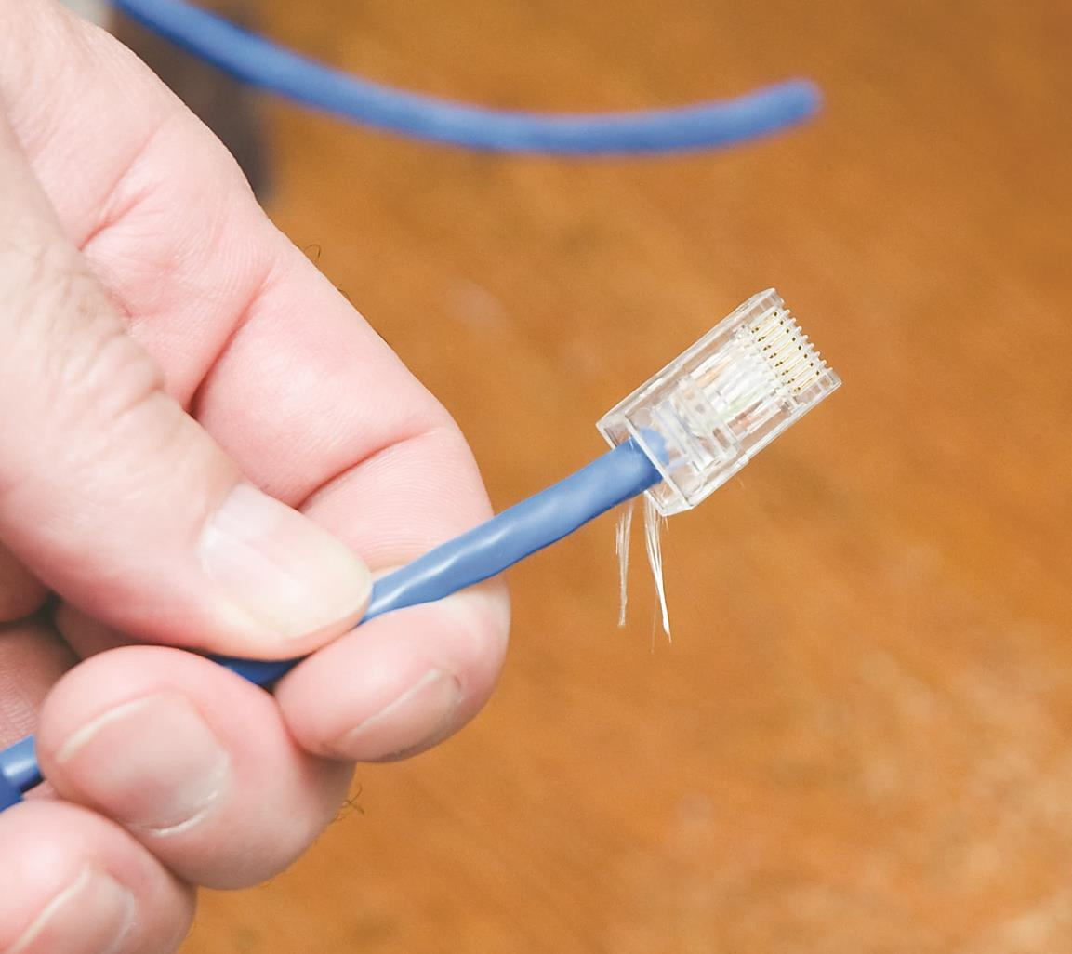
Rolling Your Own Patch Cables (6 of 7)
Figure 5.41 Properly crimped cable

Slide 77
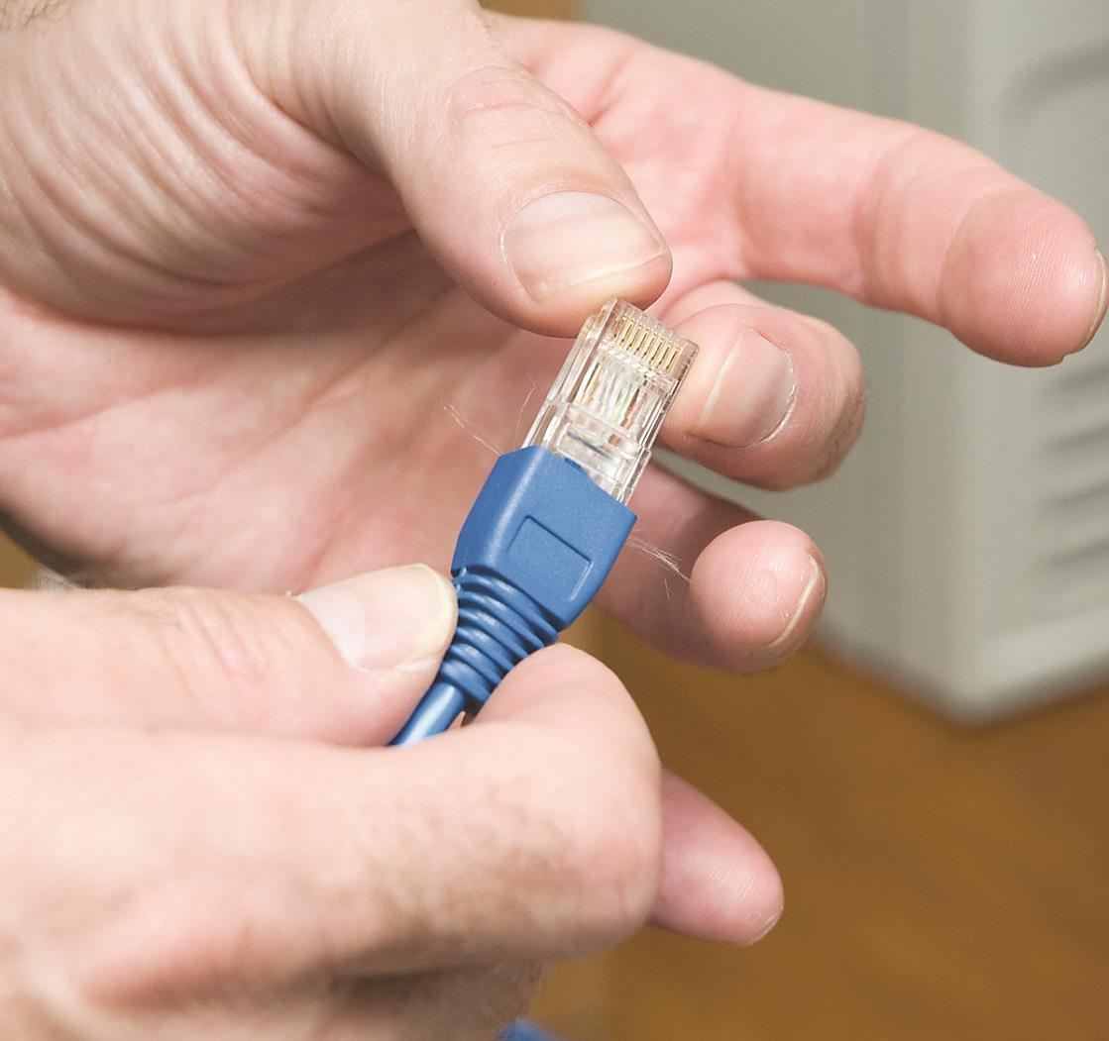
Rolling Your Own Patch Cables (7 of 7)
Figure 5.42 Adding a boot
Notes:
Try This! Crimping Your Own Cable (p. 108)
If you’ve got some spare CAT 5 lying around (and what tech enthusiast doesn’t?) as well as a cable crimper and some crimps, go ahead and use the previous section as a guide and crimp your own cable. This skill is essential for any network technician. Remember, practice makes perfect!

Slide 78
Connecting the Patch Panels (1 of 3)
Incorporate good cable management
Plastic D-rings guide patch cables neatly
Finger boxes guide individual cables
Organize to mirror the network layout
Physical or logical layout
Document everything clearly and carefully

Slide 79
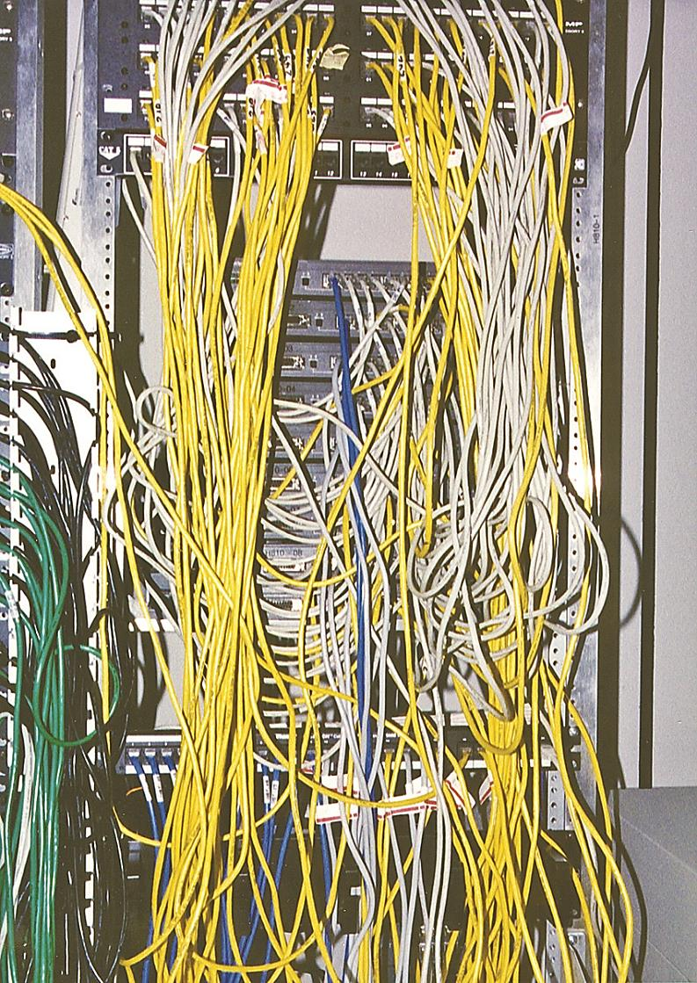
Connecting the Patch Panels (2 of 3)
Figure 5.43 Bad cable management

Slide 80
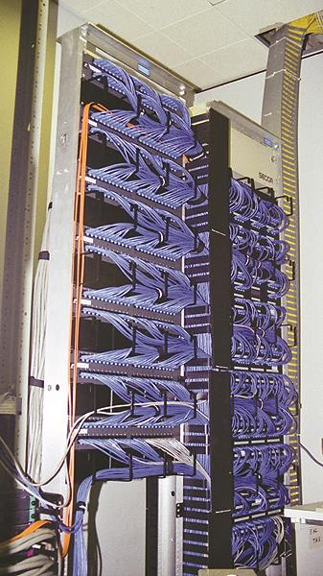
Connecting the Patch Panels (3 of 3)
Figure 5.44 Good cable management

Slide 81
Testing the Cable Runs
Verify each cable run can handle the network speed
Testing tools
Advanced tools cost $5,000 to $10,000
Lower-end tools work for basic network testing
Notes:
Note (p. 110): The test tools described here also enable you to diagnose network problems.

Slide 82
Copper Challenges
Checking a potentially bad copper cable
Examine length of the cable
Look for broken or shorted wires
Locate the point of the break
Determine whether wires are terminated in the correct place
Locate electrical or radio interference
Test for crosstalk

Slide 83
Tools to Use (1 of 5)
Cable tester
Verifies cable and terminated ends are correct
At the low-end: simple continuity testers
Better testers run wiremap test to pick up shorts, crossed wires, and more
Continuity tester
Multimeter
Notes:
Note (p. 111): Many techs and network testing folks use the term wiremap to refer to the proper connectivity for wires, as in, “Hey Joe, check the wiremap!”

Slide 84
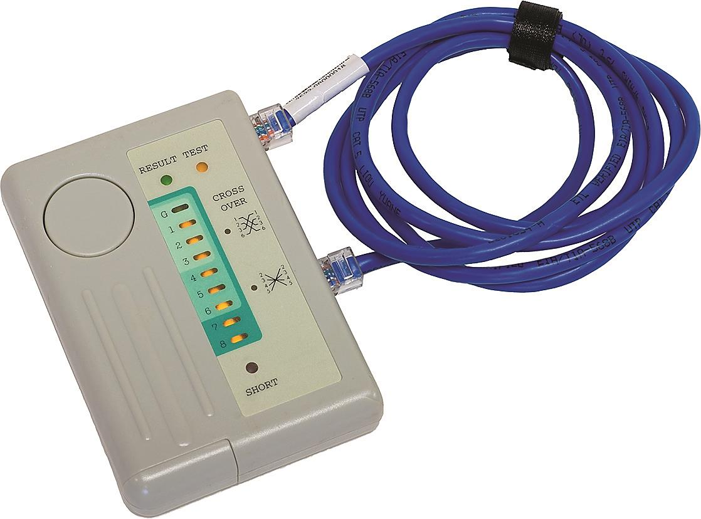
Tools to Use (2 of 5)
Figure 5.45 Continuity tester

Slide 85

Tools to Use (3 of 5)
Figure 5.46 Multimeter

Slide 86
Tools to Use (4 of 5)
Time domain reflectometer (TDR)
Medium-priced tester
Tests continuity and wiremap
Additional capabilities
Determine length of cable and location of breaks
Most come with loopback device

Slide 87
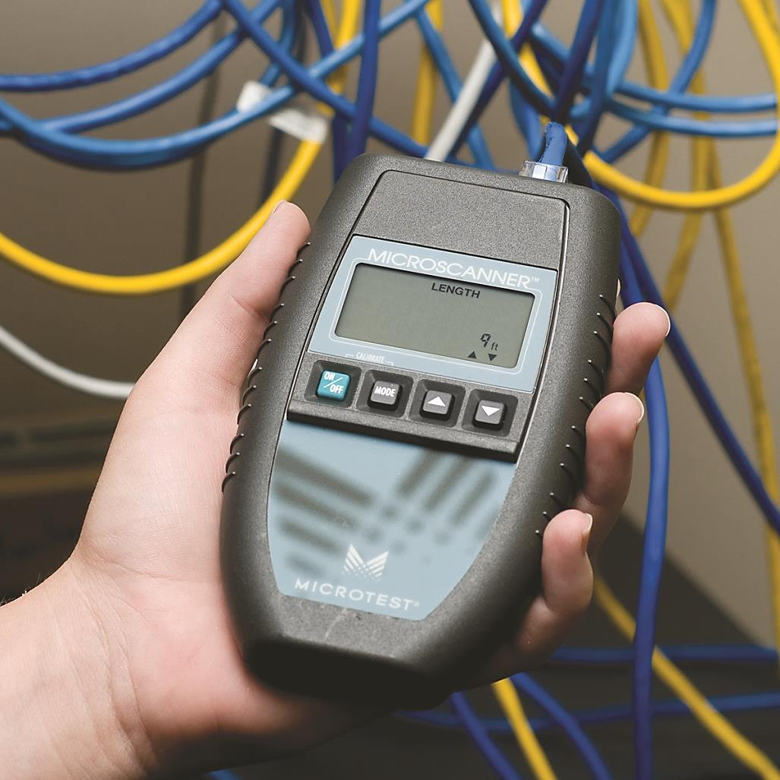
Tools to Use (5 of 5)
Figure 5.47 A typical medium-priced TDR called a MicroScanner

Slide 88
Crosstalk and Attenuation (1 of 5)
High-end testers can detect crosstalk and attenuation
Crosstalk
Near-end crosstalk (NEXT) and far-end crosstalk (FEXT)
Attenuation
Signal becomes steadily weaker as it progresses down the wire; more susceptible to crosstalk
Notes:
Note (p. 112): Both NEXT and FEXT are measured in decibels (dB). See the Tech Tip below for the scoop.
Exam Tip (p.112):
Every network—copper or otherwise—experiences data loss or lag over distances and with enough traffic. Ethernet network frame traffic has latency, a delay between the time the sending machine sends a message and the time the receiving machine can start processing those frames. Add in a lot of machines and the network will also experience jitter, a delay in completing a transmission of all the frames in a message. This is perfectly normal and modern network technologies handle jitter fine. The only time it becomes a serious problem is in real-time voice communication. Excessive jitter generally sounds like, “Dude, you’re totally breaking up.” We’ll explore voice communication in Chapter 13, “Remote Connectivity,” in some detail.

Slide 89
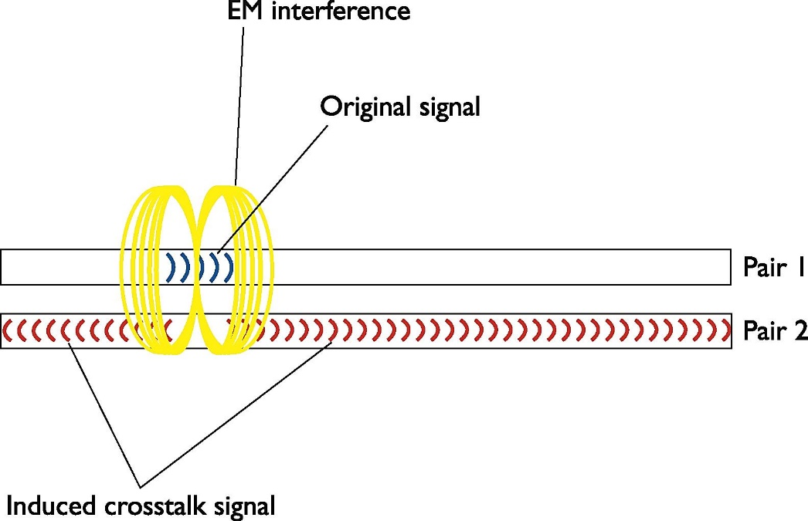
Crosstalk and Attenuation (2 of 5)
Figure 5.48 Crosstalk

Slide 90

Crosstalk and Attenuation (3 of 5)
Figure 5.49 Near-end crosstalk

Slide 91

Crosstalk and Attenuation (4 of 5)
Figure 5.50 Far-end crosstalk

Slide 92

Crosstalk and Attenuation (5 of 5)
Figure 5.51 A typical cable certifier—a Microtest OMNIScanner (photo courtesy of Fluke Networks)
Notes:
Tech Tip: Measuring Signal Loss (p. 113):
Signal loss in networking is measured in a unit called a decibel (dB). This applies to both electrical signals in copper wires and light signals in fiber cables. Unfortunately for a lot of network techs, a decibel is tough to grasp without a lot of math. I’m going to skip the technical details and give you a shorthand way to understand the numbers. When referring to a signal traveling from one end of a cable to another, you really care about how much information on that signal gets to the end, right? In a simple sense, if you have some interference, some imperfections in the cable or fiber, you’ll get some loss from beginning to end. Most people think about that loss in terms of percentage or even in more common terms, like “a little” or “a lot of” loss. No problem, right? The problem when you take that same concept to networking is that the percentages lost can be gigantic or really, really small. When you start talking about a 10,000% loss or a .00001% loss, most folks eyes glaze over. The numbers are simply too big or small to make intuitive sense. Technicians use the term decibel to describe those numbers in a more digestible format. When a tech looks at a signal loss of 3 dB, for example, he or she should be able to know that that number is a lot smaller than a signal loss of 10 dB.

Slide 93
Fiber Challenges
Signal loss is important
Measured in dB
Causes can differ
Competing standards exist

Slide 94
Signal Loss/Degradation (1 of 2)
Broken cables or open connections
Dirty connector
Connector mismatch in either cladding or core
Attenuation
Dispersion
Bend radius limitation
Light leakage occurs with too much bend

Slide 95

Signal Loss/Degradation (2 of 2)
Figure 5.52 Light leakage—note the colored glow at the bends but the dark cable at the straight

Slide 96
Physical or Signal Mismatch (1 of 2)
Physical compatibility does not imply signal compatibility
Must match single-mode or multi-mode fiber
Different runs of fiber use different wavelength signals
Fiber technician must be highly skilled
ST, SC, LC or other connector is very challenging

Slide 97

Physical or Signal Mismatch (2 of 2)
Figure 5.53 Older fiber termination kit

Slide 98
Optical Time Domain Reflectometer (OTDR) (1 of 2)
Determines continuity
Determines location of the break
Main issues with fiber
Attenuation
Light leakage
Modal distortion

Slide 99

Optical Time Domain Reflectometer (OTDR) (2 of 2)
Figure 5.54 An optical time domain reflectometer (photo courtesy of Fluke Networks)

Slide 100
NICs

Slide 101
Types of NICs (1 of 3)
Recognize different types of NICs by sight
Know how to install and troubleshoot NICs
Differences between UTP and fiber-optic NICs
UTP Ethernet NICs use the RJ-45 connector
Cable runs from the NIC to a switch
Fiber-optic NICs
Manufacturers use the same connector type for multiple standards

Slide 102

Types of NICs (2 of 3)
Figure 5.55 Typical UTP NIC
Notes:
Tech Tip: Onboard NICs (p. 115)
It’s a rare motherboard these days that doesn’t include an onboard NIC. This, of course, completely destroys the use of the acronym “NIC” for network interface card because no card is actually involved. But heck, we’re nerds and, just as we’ll probably never stop using the term “RJ-45” when the correct term is “8P8C,” we’ll keep using the term “NIC.” I know! Let’s just pretend it stands for network interface connection!

Slide 103

Types of NICs (3 of 3)
Figure 5.56 Typical fiber NIC (photo courtesy of 3Com Corp.)

Slide 104
Buying NICs
Recommend name-brand NICS, such as Intel
Extra features
Easy to replace missing driver
Recommend multispeed NICs
Stick with the same model for all systems
Notes:
Note (p. 116): Many people order desktop PCs with NICs simply because they don’t take the time to ask if the system has a built-in NIC. Take a moment and ask about this!

Slide 105
Physical Connections (1 of 2)
Physically install the NIC
Most PCs have built-in NICs

Slide 106

Physical Connections (2 of 2)
Figure 5.57 PCI NIC

Slide 107
Expansion Slots (1 of 3)
Peripheral Component Interconnect (PCI)
PCI Express (PCIe)
One-lane or two-lane varieties
USB
Convenient
Carry one in the toolkit to test for a failed NIC

Slide 108

Expansion Slots (2 of 3)
Figure 5.58 PCIe NIC

Slide 109

Expansion Slots (3 of 3)
Figure 5.59 USB NIC

Slide 110
Drivers
Insert the driver CD when prompted
OS likely has a preinstalled driver
Using the CD offers additional features and utilities
Verify the driver install
Windows: Device Manager
Ubuntu Linux: Network applet
macOS: Network utility in System Preferences

Slide 111
Bonding
Link aggregation
Doubles (or more) the speed between a machine and a switch
Use identical NICs and switches from the same companies
Notes:
Exam Tip (p. 117): The Link Aggregation Control Protocol (LACP) controls how multiple network devices send and receive data as a single connection.

Slide 112
Link Lights (1 of 6)
UTP NICs have LEDs giving information about link state
One to four link lights per card
Lights give clues about what is happening
Check the link lights first
Tells you that the NIC is connected to a switch
Switches also have link lights
Multispeed devices have a link light that indicates speed

Slide 113

Link Lights (2 of 6)
Figure 5.60 Mmmm, pretty lights!

Slide 114

Link Lights (3 of 6)
Figure 5.61 Multispeed lights

Slide 115
Link Lights (4 of 6)
Activity light
Turns on when network traffic is detected
Intermittently flickers when operating properly
Collision light
Present on some older NICs
Flickers when it detects collisions on the network
Fiber-optic NICs
Many do not have lights

Slide 116

Link Lights (5 of 6)
Figure 5.62 Link lights on a switch

Slide 117

Link Lights (6 of 6)
Figure 5.63 Optical connection tester

Slide 118
Diagnostics and Repair of Physical Cabling

Slide 119
Diagnosing Physical Problems (1 of 3)
Try to eliminate software issues
If one application fails, try another
Resolve hardware issues
If all systems connected to one switch no longer see the network, the problem is likely the switch
Check your lights
Have the user check connection status through link lights or software

Slide 120

Diagnosing Physical Problems (2 of 3)
Figure 5.64 Disconnected NIC in Windows

Slide 121
Diagnosing Physical Problems (3 of 3)
Check shared resources (servers)
Visually check cabling
Plug the system into a known good outlet
If this works, suspect:
Structured cabling running from the original outlet to the switch, or
A bad connector
Confirm with a continuity test

Slide 122
Check the NIC (1 of 2)
Detect a bad NIC with an operating system utility
Use available NIC diagnostic software
Loopback test on NIC
Internal only checks circuitry
External (with loopback plug) tests the connecting pins
Notes:
Note (p. 120): Onboard NICs on laptops are especially notorious for breaking due to constant plugging and unplugging. On some laptops, the NICs are easy to replace; others require a motherboard replacement.

Slide 123

Check the NIC (2 of 2)
Figure 5.65 Loopback plug or adaptor

Slide 124
Cable Testing (1 of 2)
Most problems occur at the work area
Test a cable run, including the patch cables
Check the coupler if one is used to extend a cable run

Slide 125

Cable Testing (2 of 2)
Figure 5.66 Loopback plug in action

Slide 126
Problems in the Telecommunications Room
Keep the diagnostic process organized and documented
Biggest concerns: power and environmental issues
Uninterrupted power supply (UPS)
Is a battery backup that plugs into the wall
Has built-in monitoring
Enables orderly shutdown
Notes:
Tech Tip: Online vs. Standby Power Supplies (p. 121)
You can purchase two different types of UPSs—online and standby. An online UPS continuously charges a battery that, in turn, powers the computer components. If the telecommunications room loses power, the computers stay powered up without missing a beat, at least until the battery runs out.
A standby power supply (SPS) also has a big battery but doesn’t power the computer unless the power goes out. Circuitry detects the power outage and immediately kicks on the battery.

Slide 127
Monitoring Tools (1 of 2)
Voltage event recorder
Plugs into a power outlet
Tracks voltage over time
Environmental monitor
Keeps a constant watch on humidity, temperature, and more
Notes:
Note (p. 122): Using a high-quality UPS, installing temperature and environmental monitors; these fall into a much larger discussion called “managing risk.” Managing risk a big topic, so I’ve devoted the entire Chapter 18, Managing Risk,” to it.

Slide 128

Monitoring Tools (2 of 2)
Figure 5.67 An excellent voltage event recorder (photo courtesy of Fluke Networks)

Slide 129
Toners (1 of 3)
Device for tracing cables
Consists of a tone generator and a tone probe
Often referred to by brand-name “Fox and Hound”
Butt set
Classic tool used by telephone repair technicians
Notes:
Exam Tip (p. 122): You’ll see a tone probe referred to on the CompTIA Network+ exam as a toner probe.

Slide 130

Toner (2 of 3)
Figure 5.68 Fox and Hound

Slide 131

Toner (3 of 3)
Figure 5.69 Technician with a butt set
Notes:
Another example of a tone probe

